Slide 1

RockStat
November 9, 2017

Slide 2
Rockford Police Department
PRESENTED BY:
Kevin Ogden – Assistant Deputy Chief

Slide 3
Rockford Police Department
Key Strategic Initiatives
2017
Reduce Violent Crime
Improve Community Engagement
Improve Traffic Safety
Improve Employee Development
Enhance Organizational Development/Capabilities

Slide 4
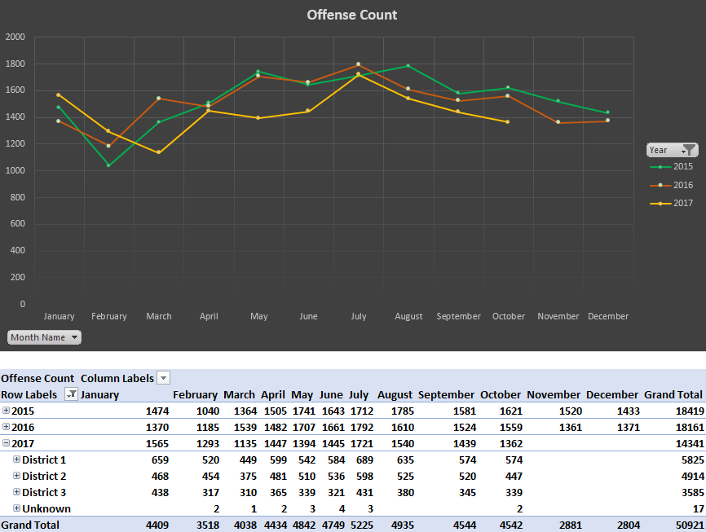
Rockford Police Department
NIBRS Group A Offense Count 2015-2017

Slide 5
Rockford Police Department
Group A Comparison
Violent Crimes / Property Crimes

Slide 6
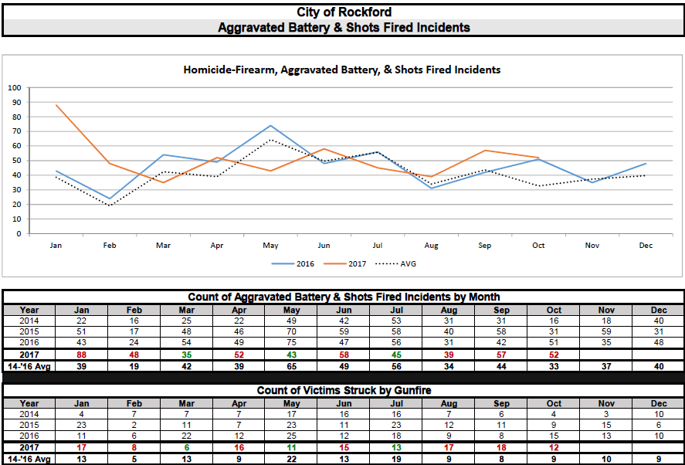
Rockford Police Department
Aggravated Battery / Shots Fired 2014-2017

Slide 7
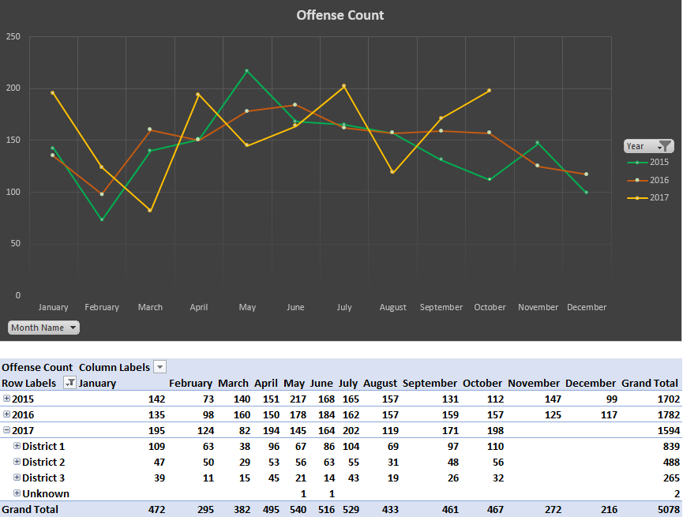
Rockford Police Department
Aggravated Assault 2015 - 2017

Slide 8
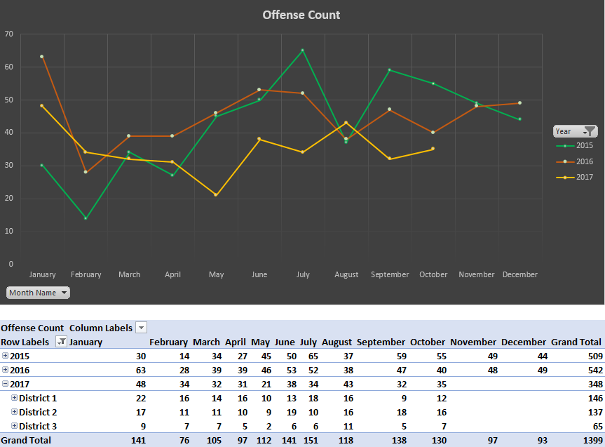
Rockford Police Department
Robbery 2015 - 2017

Slide 9
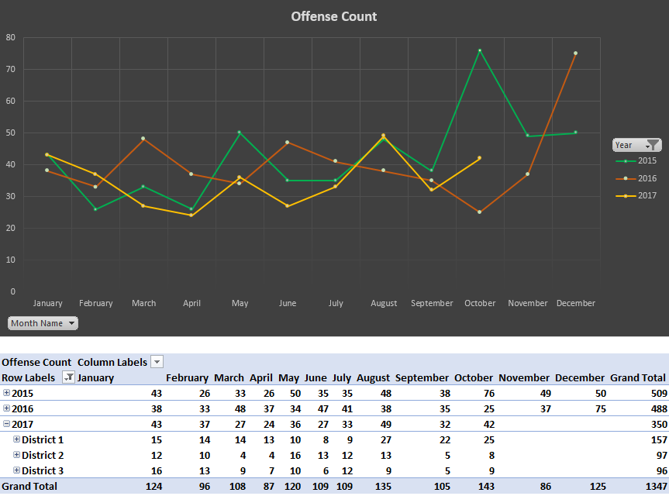
Rockford Police Department
Auto Thefts 2015 - 2017

Slide 10
Rockford Police Department
Traffic Accidents 2014 - 2017

Slide 11
Rockford Police Department
Accomplishments
National Coffee with a cop (10 locations)
Bombing Drill at BMO
Lethality Assessment Program (LAP) Training
Fall Games opening ceremonies for the Special Olympics
Wheelchair basketball exhibition game Police v. Rockford Chariots
Red Robin fundraiser event for Special Olympics
Personal safety presentations Heartland Hospice staff and Allen Chapel
Initiated liquor license restrictions on Broadway Food & Liquor
Bank robbery training (First Community Credit Union)
Rockhouse Kids Recreation Night at D2 gym
Rock Officers Event - Pumpkins with the Police, over 200 attendees
Boo Bash at Lewis Lemon
Trunk or Treat with Ellis
Trick or Treat with LaChiquita
City Wide Trunk or Treat over 2,000 attendees
Safe trick or treating Public Service Announcement with 97 ZOK
2 Speed Trailer deployments (1200 Esmond Dr, 500 Pierpont Ave)
Rockford PD received the AAIM award (Alliance Against Intoxicated Motorists) for Most DUI arrests in entire state of IL (excluding Chicago)

Slide 12
Rockford Fire Department
PRESENTED BY:
Derek Bergsten – Fire Chief

Slide 13
Rockford Fire Department
Key Strategic Initiatives
2017
Maintain and improve health and safety throughout the organization
Enhance career related training and development throughout all department levels
Continually improve and enhance delivery of service to the citizens
Recruit and retain a diverse and effective workforce
Foster community outreach and agency partnerships

Slide 14
Rockford Fire Department
Scorecard

Slide 15
Rockford Fire Department
Incidents

Slide 16
Rockford Fire Department
Sprinkler Systems
Recent examples of building fires with sprinkler system activations

Slide 17
Rockford Fire Department
Achievements
Continued work with Alignment Rockford, RPS 205, and Police Department on Public Safety Career Pathways
Fire Maintenance Facility approved for site visit for Accreditation
Appointed new Mobile Integrated Health (MIH) Paramedic as part of the Humana partnership
Appointed new Inspector to fill vacancy
Conducted Full Scale Exercise at BMO Harris Bank Center
Participated in many events for Fire Prevention Week
Working with media to increase awareness of opioid use

Slide 18
Rockford Fire Department
Areas of Improvement
Continue to work on 911 Center Consolidation agreements
Prepare for testing for Mobile Integrated Health position to establish a promotional list
Partnership with American Red Cross to install smoke detectors on November 22nd

Slide 19
Human Services
PRESENTED BY:
Jennifer Jaeger – Community Services

Slide 20
Community Services
PRESENTED BY:
Jennifer Jaeger- Community Services Director

Slide 21
Community Services Key Strategic Initiatives
2017
Training and Employment
Education
Healthy Homes/Energy Efficiency
Emergency Assistance
Housing/Homeless

Slide 22
Human Services-Community Services
Through partnerships with Rock Valley College and Zion West, we’ve been
able to move 17 persons from poverty to living wage jobs.

Slide 23
Human Services-Community Services
Community Action provides
post secondary scholarships of at
least $1,000 to at least 5 students
annually with 80% staying in college
and/or graduating.

Slide 24
Human Services-Community Services
We continue to invest in making homes more energy efficient and safer for low
income home owners, every dollar we invest in weatherization results in energy
savings at a greater than 1:1 ratio.

Slide 25
Human Services-Community Services
In addition to state/federal emergency funds, we also manage CFNIL crisis funds and RRWRD assistance funds.

Slide 26
Human Services-Community Services
In addition to our work with the homeless we work to prevent homelessness
and stabilize families. Over 80% of those we help remain stably housed.

Slide 27
Human Services-Community Services
We have now sustained functional zero for veteran homelessness
for 22 months, all new veterans entering homelessness are
housed within 30 days.

Slide 28
Human Services-Community Services
We reached functional zero for the chronically homeless (a year plus
literally homeless and a diagnosed disability)in January, 2017

Slide 29
Department-Division (If applicable)
Achievements
We just received notice last week from the United States Interagency
Council on Homelessness (USICH) and the Department of Housing and
Urban Development (HUD) that they have completed the review of our data
and verified that we achieved functional zero for chronic homelessness. We are
one of only three communities in the nation to receive this certification and the
only community to receive this certification for both veteran and chronic
Homelessness.
Community Solutions (Built for Zero) has invited us to be one of five communities
to participate in a special initiative to end all homelessness.

Slide 30
Department-Division (If applicable)
Areas of Improvement
We have started our efforts to end youth homelessness. A homeless youth
is defined as an unaccompanied or parenting youth aged 16-24 who is living
on the streets, in a shelter or a place not meant for human habitation.
We are seeking a new funding stream to support this effort, the HUD Youth
Homelessness Demonstration Program, only ten are awarded each cycle.
This is cycle two.
We are also seeking funding through the Drug Free Communities Grant with
a focus on opioid addiction prevention.

Slide 31
Head Start
PRESENTED BY:
Faniqua Hughes, Co-Interim Director and Support Services Manager
Kris Homb, Home Base Services Manager

Slide 32
Head Start/Early Head Start/Early Head Start – Child Care
2016 – 2017 Demographics
837 Children received services
            88 children had a diagnosed disability
            37 children in foster care
            30 children experienced homelessness during the program year
            Of 770 families served
              609 are single parent families
                257 single parent families are unemployed
              161 two parent families
                37 two parent families, both parents are unemployed
              239 families have less then a high school education
              228 enrolled families have a primary language other than English

Slide 33
Early Head Start Screening Outcomes
Ages Birth – 3
Percentage of children who met developmental milestones
Period 1 Period 2 Period 3 Period 1 Period 2 Period 3 Period 1 Period 2 Period 3 Period 1 Period 2 Period 3 Period 1 Period 2 Period 3
Percentages based on 58 children who completed program year out of the total enrollment of 117.

Slide 34
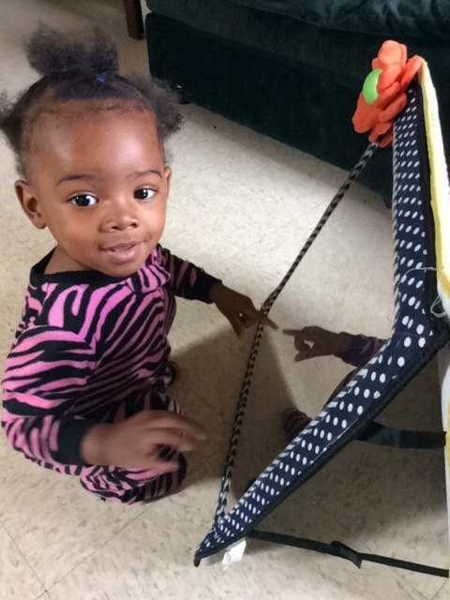
Early Head Start Screening Outcomes
Ages Birth – 3
16 children identified as failing one or more learning areas during the year.
3 entered Early Head Start already receiving
Early Intervention (EI) services.
Remaining 13 were referred to Early Intervention
services.
8 of the 13 (61%) were found eligible to receive
additional services through Early Intervention.

Slide 35
Head Start Child Outcomes
Ages 3-5 Years
Percentage of children who meet or exceed developmental objectives

Slide 36
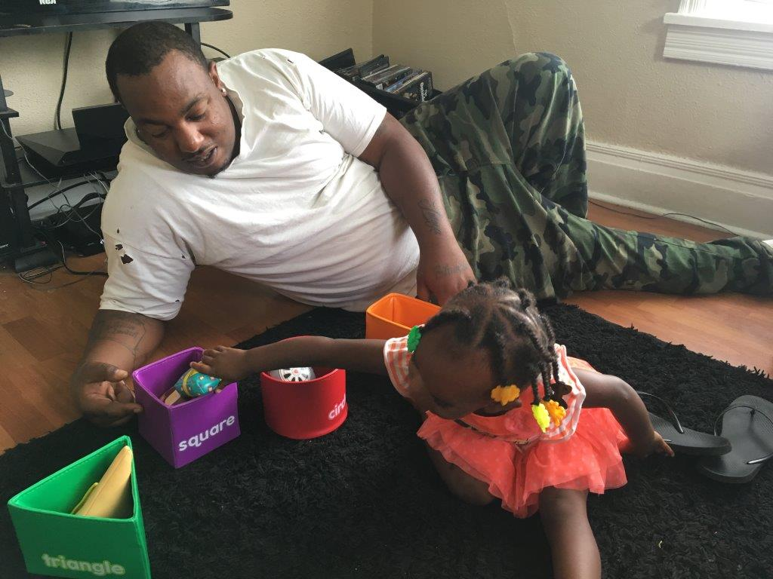

Head Start
Achievements
Chamber of Commerce Confluence Award for great Partnerships/Collaborations with the Music Academy in Rockford.
Full Enrollment in Early Head Start – very close in Head Start.
New Partnership with YMCA Children’s Learning Center to serve 15 children.

Slide 37
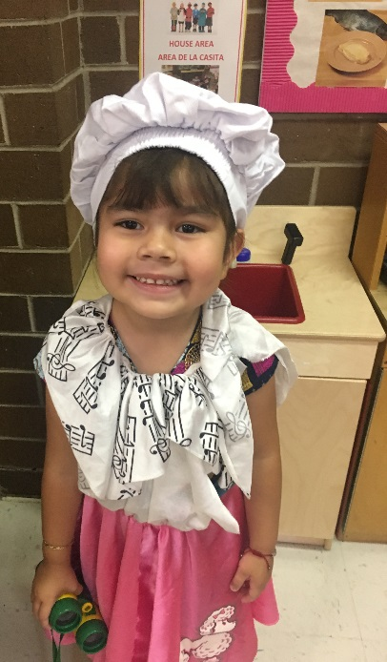
Head Start
Areas for Improvement
Reach full enrollment at Head Start Sites.
Develop Single Point of Entry with Rockford Public Schools Early Childhood and other local early childhood agencies.
Explore additional options for In-Kind in the community.
Develop new polices and procedures to address the revised Head Start Performance Standards.
Full staffing of critical positions especially
  for bus drivers and teachers.
Complete proposal for new 5 year
  Head Start/Early Head Start grant.

Slide 38
Community and Economic Development
PRESENTED BY:
Vicki Manson – Housing and Program Manager
Robert Wilhelmi – Neighborhood Standards Supervisor

Slide 39
Community & Economic Development Department
Key Strategic Initiatives
2017
Code Enforcement Improvement
Neighborhood and Housing Improvement
Commercial Corridors
Global Trade Park - Land Use & Marketing Plan
Central Planning Area

Slide 40
CEDD – Neighborhood Development
PRESENTED BY:
Vicki Manson, Housing & Program Manager

Slide 41
CEDD – Neighborhood Development
Scorecard

Slide 42
CEDD – Neighborhood Development
Dashboard

Slide 43
CEDD – Neighborhood Development
Achievements
All Mow to Own program participants are in compliance. Nine total participants, including 3 new signed MOUs in 2017.
After evaluating the housing stock of properties valued under $110,000, we are initiating a new streamlined housing rehabilitation program for 2018.
Marketing efforts in 2017 included 58 marketing events (55 workshops attended by staff, 3 events with only materials provided). Continued networking has created a steady flow of applicants for the housing programs.
Over $1.1 million was obligated on housing projects, including 10 homebuyers and 27 FAR rehabs alone. This was an increase of 61% for these two programs.
Continue to enhance professional skills and become more knowledgeable of HUD rules and regulations through webinar training.

Slide 44
CEDD – Neighborhood Development
Areas of Improvement
Increase the number of lead-licensed rehabilitation contractors.
Maintain a pipeline of eligible Community Housing Development Organizations and develop quality projects.
Continuously evaluate programs to streamline efforts and maximize funding dollars to help as many applicants as possible.
Update CDBG program policies and procedures.

Slide 45
CEDD – Neighborhood Standards
PRESENTED BY:
Robert Wilhelmi, Neighborhood Standards Supervisor

Slide 46
CEDD – Construction & Development Services
2017 Neighborhood Standards Code Enforcement Trends (Jan – Oct)

Slide 47
CEDD – Construction & Development Services
2017 Neighborhood Standards Code Enforcement Case Trends (Jan – Oct)

Slide 48

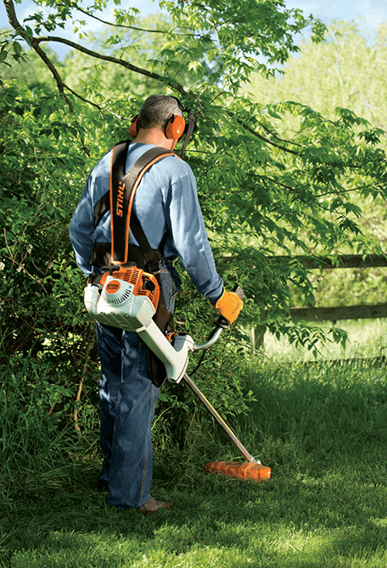
CEDD – Construction & Development Services
2017 Weeds Abatement Program (Thru October 30)
3/28/2017 - First weeds complaint received (3/22 in 2016)
1,726 total service requests for weeds resulting in 1,068 cases
5,621 total weeds cases started (5,011 in all of 2016), 12.2% increase
28% or 1,510 are 1st violations or outside 36 month probation window (31% or 1,535 in all of 2016)

Slide 49
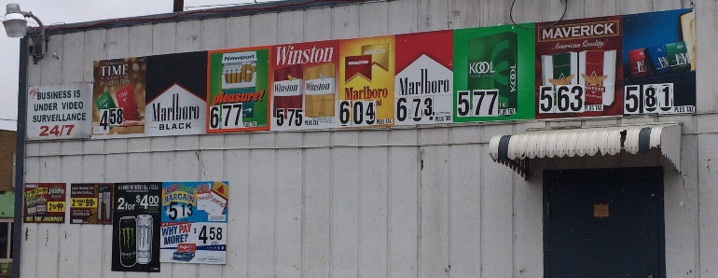
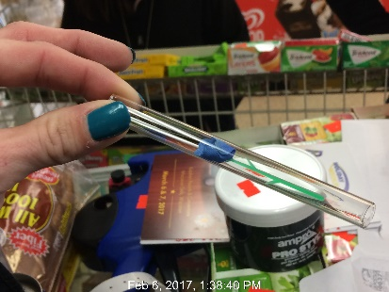
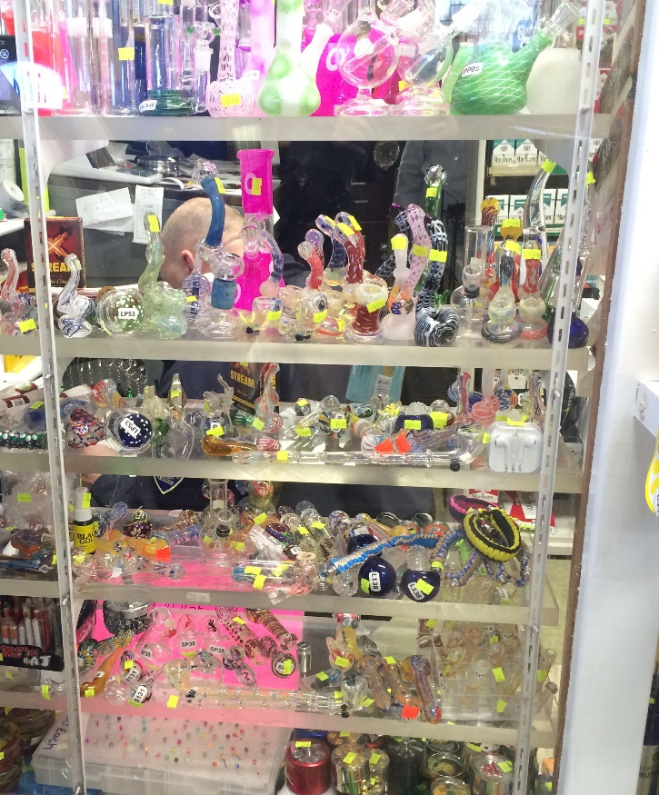
CEDD – Construction & Development Services
2017 City-Wide Tobacco Sweep (March – Current)
Comprehensive inspection of 164 businesses, 147 with active Tobacco License on record
49 businesses found to be in violation, violations include:
  Signage (55)
  SUP Conditions (51)
  No City Tobacco License (29)
  Sale of drug paraphernalia items/pipes (20)
  City Tobacco License not displayed (33)
  Exterior property/landscaping violations (14)
  Bars on windows/doors (8)
  Tobacco Licenses Nontransferable (3)
  Amusement License required (3)
  Operating during unapproved business hours (3)
  Alcohol related (3)
$60,500 in fines assessed, $50,250 paid to date (84%)

Slide 50
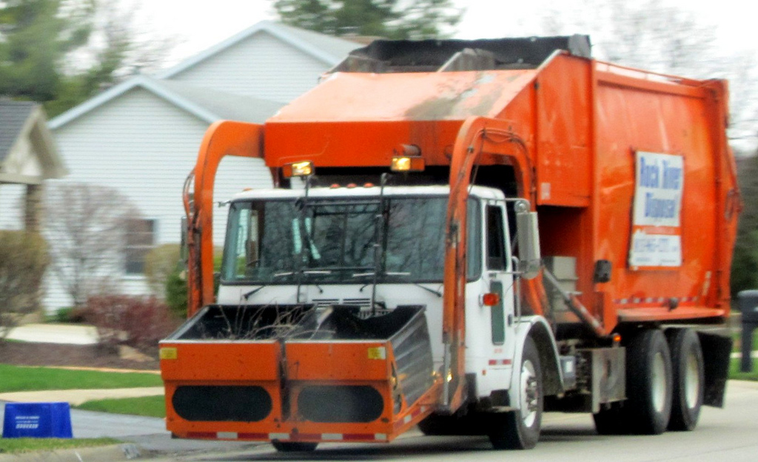
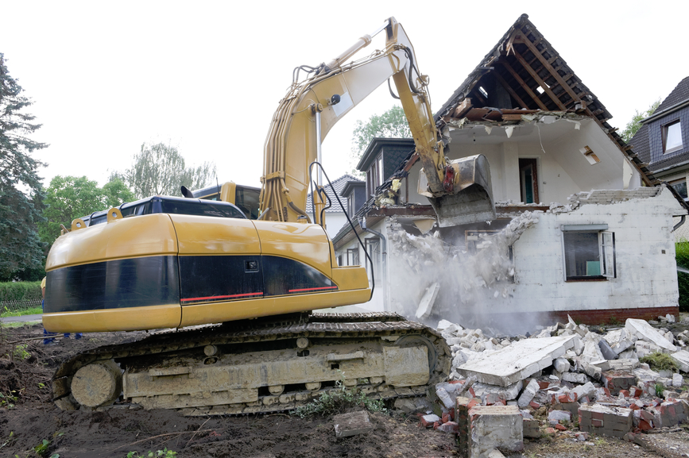
CEDD – Construction & Development Services
2017 Sanitation Statistics (Jan – Sep)

Slide 51
CEDD – Construction & Development Services
2017 Electronic Waste Program (Jan – Sep)

Slide 52
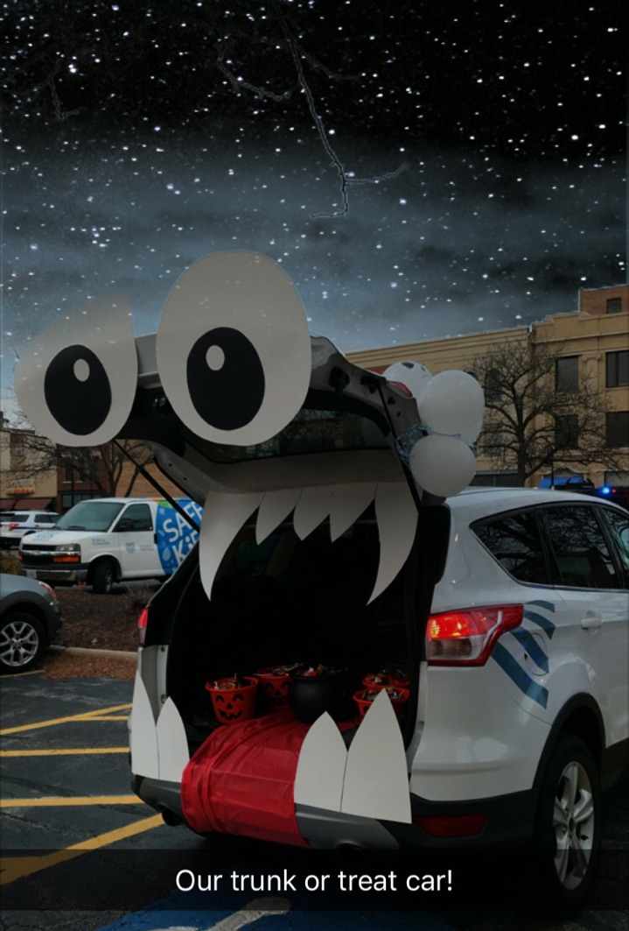
CEDD – Construction & Development Services
Achievements/Improvements (June – Current)
Achievements
  2017 Tobacco Business Sweep
  Represented at Trunk or Treat and National Night Out
  Provided sanitation/disposal assistance for Project 1013
  Relocation of E-Waste program to KNIB
  Weeds Ordinance violation height reduced from 10 inches to 8 inches, effective 2018
Future Areas of Improvement
  Improved Zoning Ticket Program (anticipated November 2017 commencement)
  Improve fine collection process
  Improve Used Tire Collection Program
  Revise/Strengthen Tobacco/Liquor Ordinances

Slide 53
Finance Department
PRESENTED BY:
Gus Saros – Customer Service Supervisor

Slide 54
Finance Department-Customer Service

Slide 55
Finance Department-Customer Service
Call Volume

Slide 56
Finance-Customer Service Center
Wrap Up Code

Slide 57
Finance Department- Customer Service

Slide 58
Finance Department- Customer Service

Slide 59
Finance Department- Customer Service

Slide 60
Customer Service Center
Accomplishments
Areas of Improvement
Implementation of Private Property Tree Removal Loan Program
Launch of a “Clean-up” customer account information update
Improve communication across City departments to ensure we have the most up to date information to assist customers
Continue to communicate with other departments to find solutions on pending issues affecting our billing and setting up processes in place to increase efficiency.
Work on a timeline to implement Citizen’s Self Service and revise forms/documents in preparation for upcoming changes

Slide 61
Public Works
PRESENTED BY:
Kyle Saunders – Water Superintendent
Mitch Leatherby – Street & Transportation Superintendent
Kwame Calvin – Assistant Street Superintendent

Slide 62
PUBLIC WORKS
Key Strategic Initiatives
2017
Balanced infrastructure system inclusive of road, rail, parking, pedestrian and alternative modes of transportation
Improved infrastructure & redevelopment to attract businesses to the City of Rockford
Street maintenance program which provides commuters with clean, safe and well-maintained streets
Operate and maintain the public water system in a manner that protects public health and enhances the community
Maintain a stormwater management program that protects the public and the environment while enhancing the community

Slide 63
Water Division
Presented by:
Kyle Saunders
Water Superintendent

Slide 64
Water Division
Dashboard

Slide 65
Water Division
Water Production (YTD)
-1.8%
-2.4%
-2.1%
-1.0%

Slide 66
Water Division
Revenue Budget to Actual - Variance
Revenues are $145,653 over budget
-0.14%
-0.84%
-1.17%
-1.59%
-2.16%
-2.91%
-1.68%
-1.33%
-0.57%
+0.51%

Slide 67
Water Division
Summer Operations Statistics (YTD)
 | 2017 Actual | 2017 Goal | Forecast Complete (#) | Forecast Complete (%) | Performance Indicator
Hydrant Flushing Miles (Apr-Nov) | 280 | 250 | 300 | 120%
Hydrant PM (Apr-Nov) | 1035 | 600 | 1055 | 176%
Hydrant Painting (Apr-Oct) | 795 | 560 | 815 | 146%
Fireflow Testing (Sep-Nov) | 450 | 1000 | 720 | 72%
ERT Replacement (Mar-Nov) | 2334 | 3400 | 2710 | 80%
*

Slide 68

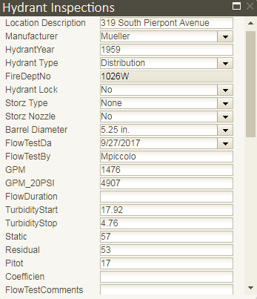
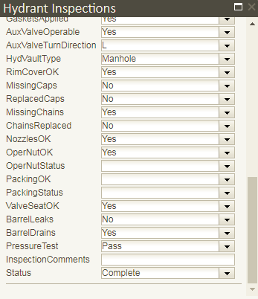
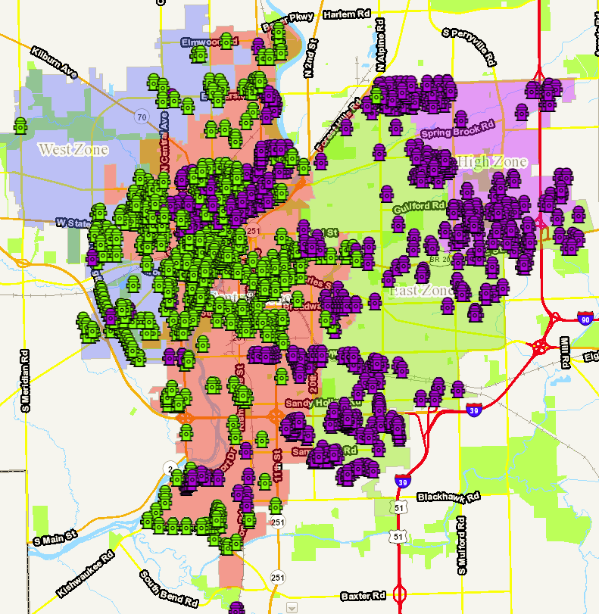
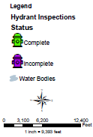
Water Division
Fireflow Testing and Hydrant Inspections

Slide 69
Water Division
Accomplishments:
Areas of Improvement:
Park Ave Water Main Replacement – Construction (400 LF – Risk Based)
Production Meter Validation(s)
Large Meter Inspection(s)
SE Superfund Water Service Connection(s) and Well Abandonment(s)
FY 2017 Hydrant Flushing Program
ISO Fireflow Testing and M17 Hydrant Inspections (550 Hydrants)
U31/U34 Well Rehabilitation(s)
Large Meter Compound Insert(s)
Stanley St Radium Treatment – Construction
Additional Zone 17 Hydrant Flushing

Slide 70
Engineering Division
Presented by:
Kyle Saunders
Water Superintendent

Slide 71
Engineering
Dashboard

Slide 72
Engineering Division
Accomplishments:
Areas for Improvement:
Stormwater Detention Basin Maintenance Inspections completed on target
439 basins inspected with 0 requiring major maintenance compared to 18 in 2013; 50pct required no maintenance which is the best percentage since 2011
Continue to improve on amount of ROW permits open
Continue to strive for 1 day turn around on all permits
Work on process improvement for new Development and Site plan review in coordination with Building and Zoning Division

Slide 73
Street & Transportation
Presented by:
Mitch Leatherby
Street & Transportation Superintendent

Slide 74
Street Department
Dashboard

Slide 75
Street / Forestry
Forestry Requests
Forestry Requests
Pothole Requests

Slide 76
Street / Forestry
Total Open Requests

Slide 77
Snow and Ice Prep
Preparation began end of summer, final step is snow ticketing meeting in Mid-November
Currently all driver routes are filled and contractor meetings have taken place
Depending on operational needs, would like to spend more time this season in residential areas; i.e. salting and overall better cleanup after storms

Slide 78
Street / Forestry
Achievements
Stayed on top of patch requests throughout the year by maintaining an average monthly completion of 99%
Continued success of the Emerald Ash Borer treatment program – Forestry staff saved 341 trees by treating them this year
Aggressive creek cleaning/clearing
Forestry department assisting in the implementation and inspection portion of the Private Tree Removal program

Slide 79
Street Department
Areas of Improvement
Forestry Department
          Pruning and removal numbers have been slightly lower as a result of transitioning staff levels and backlogged requests from the summer months. Hope to get back on track soon.
          Tree Replacement program – Continuing to look for ways to increase public awareness
Sign Department
          MUTCD signage replacement still in progress

Slide 80
Graffiti
Presented by:
Kwame Calvin
Assistant Street Superintendent

Slide 81
Public Works – Graffiti
2017 YTD Dashboard

Slide 82
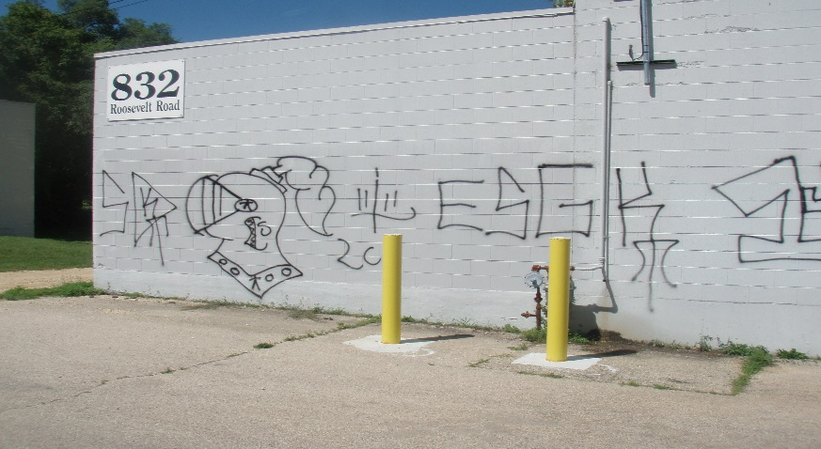
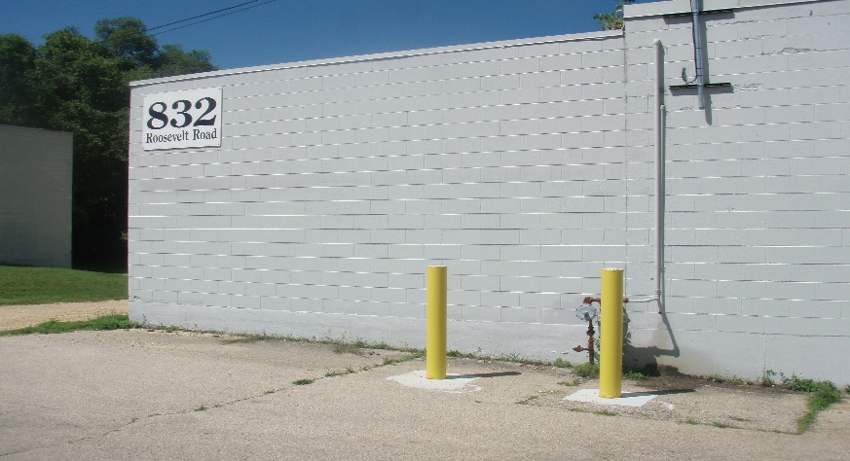
Public Works – Graffiti
Statistics
Before
We have a 26% reduction in graffiti this year compared to last year. We have (432) cases this year compared to (582) cases in the first 10 months of 2016
We have a 62% decrease in graffiti over the last 4 months of this year(133) compared to last year(348)
Kids graffiti (22%) has the biggest spike and slap tags(1%) has the biggest decline from the graffiti cases identified.
Graffiti removal time is( 1) day average since daily removal started April 1st.
After

Slide 83
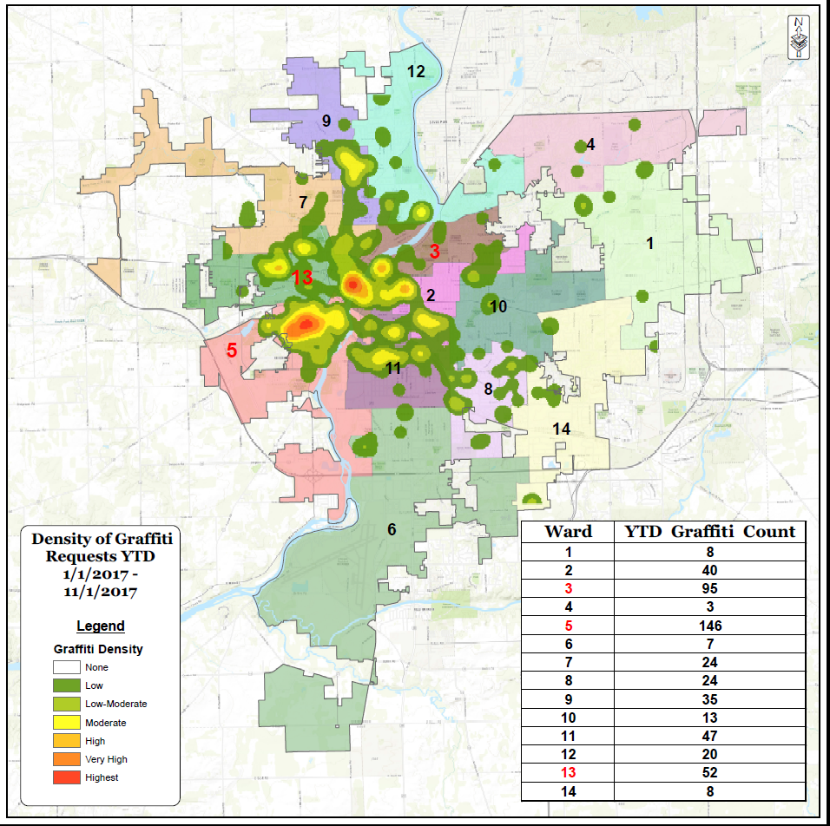
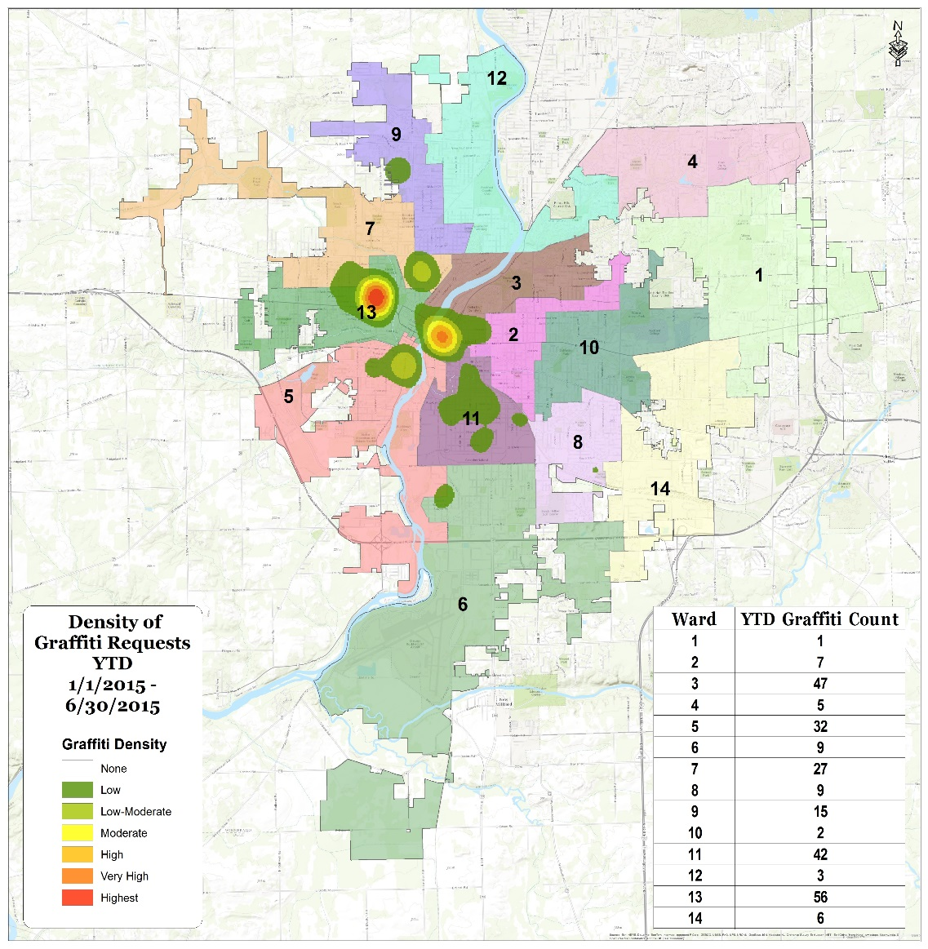

Public Works – Graffiti
Graffiti by Wards
Ward #5 has the highest amount of graffiti cases (146) in the first 10months.
Ward #6 has the lowest amount of graffiti cases with (7) this year.
Wards 3, 5 & 13 make up 58% of all graffiti cases

Slide 84
Public Works – Graffiti
Achievements
Areas of improvements
Graffiti response and abatement time is a 1-day average since April 1st
( Lowest all year).
Graffiti 26% decline in this year.
October Graffiti lowest total to date (13).
Finishing strong- last 4 months averaged 33 cases as compared to 87 cases during same time period last year.
Wards 3, 5 & 13 make up 58% of all graffiti cases

Slide 85
Questions?

Slide 86


