Slide 1


PROJECTDOX 9.2 TRAINING
PRESENTED BY: CITY OF ROCKFORD

Slide 2
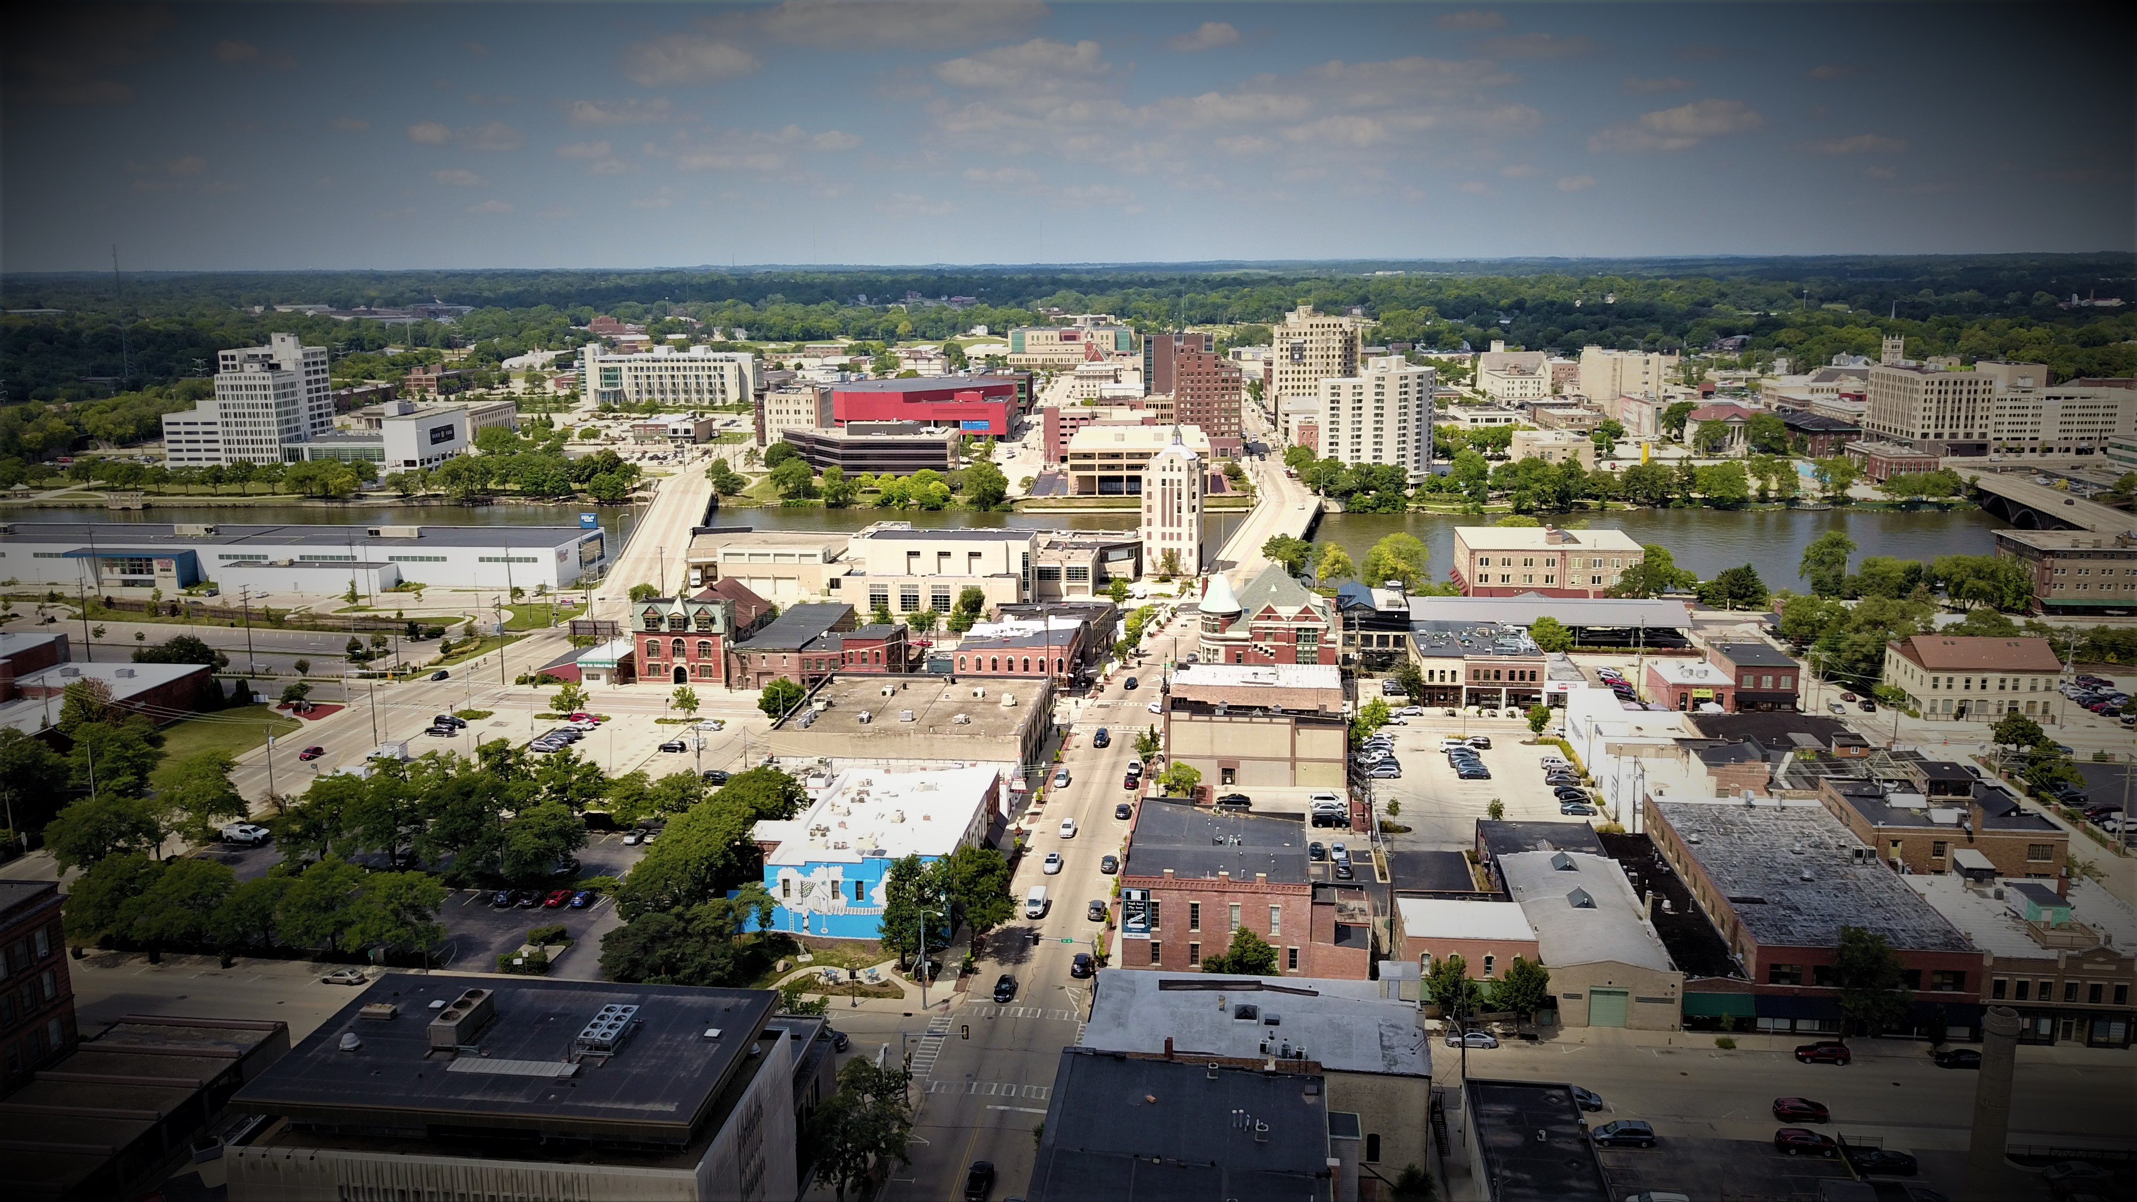
City of Rockford
Inspection services date back to the early 1900’s.
Currently on 2015 ICC code cycle, will be moving to 2021 ICC code cycle later this year.
City on average does 800-1,000 plan reviews a year across all departments.
City averages 11,000 inspections a year.
Average project review time of 7 calendar days.

Slide 3

ProjectDox
Founded in 2008, Avolve Software has delivered one of the industry’s leading Electronic Plan Review software.
Started with a single goal in mind — automate the manual, paper-intensive, and frequently inefficient building plan review process.
Today, over 150 of North America’s city, county, and state governments use ProjectDox
Avolve is the largest, independent software vendor dedicated exclusively to eplan review.

Slide 4
Why ProjectDox?
All the project information including documents, drawings, annotations, comments and markups are centralized in one location. This means easier access for everyone who has been invited to the project
Project Dox enables multiple-users access to the same information at the same time, making it easier for reviews to collaborate to verify all projects meet city requirements while also increasing response time on plan reviews.
Notification features make sure that when reviews take place on the project, those who need the updated information can be informed immediately.
All details of project activities are recorded, comprising a complete audit trail for documents, emails, forms, annotations markups, and comments.
Anytime online submission, no requirements to drop plans off at city hall.
Sustainability for all parties - no paper storage, increase lobby traffic or ineffective plan revision tracking.
Supports teleworking, submitting plans and internal staff reviews can be done anywhere.

Slide 5
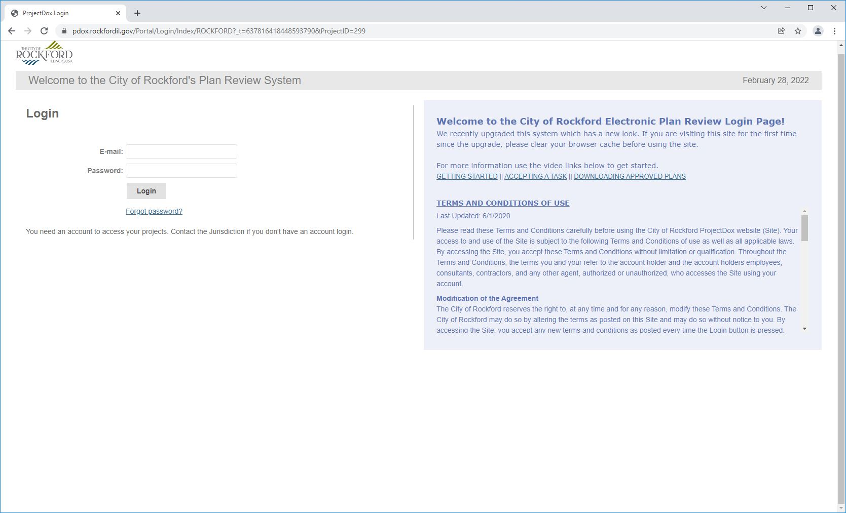
Benefits in ProjectDox 9.2
Easier Task and Project Acceptance.
Step-by-Step instructions and easy guide videos.
Easier for applicants to respond to comments, with all review comments in one place.
Download link to access markups as downloadable fillable form.

Slide 6
Training Videos

Slide 7
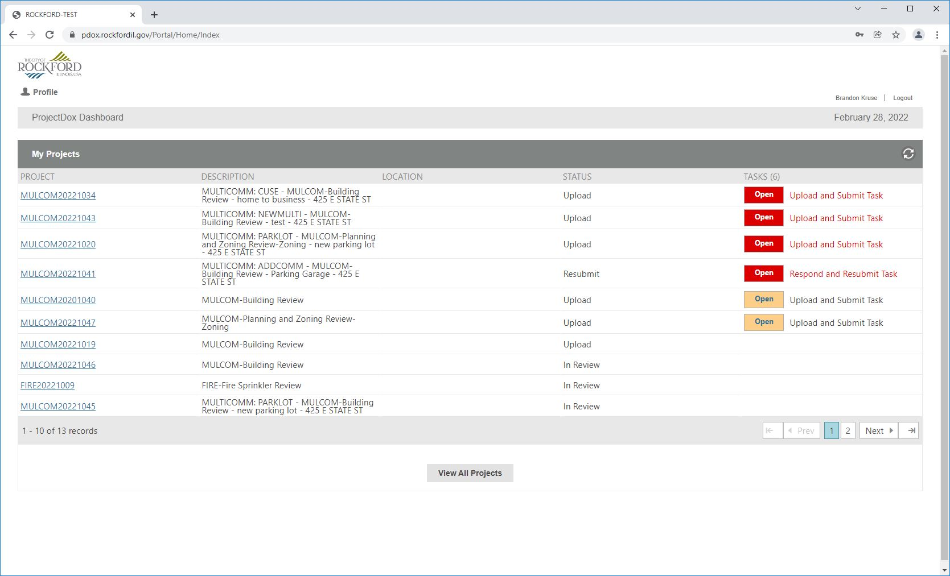
ProjectDox Dashboard

Slide 8
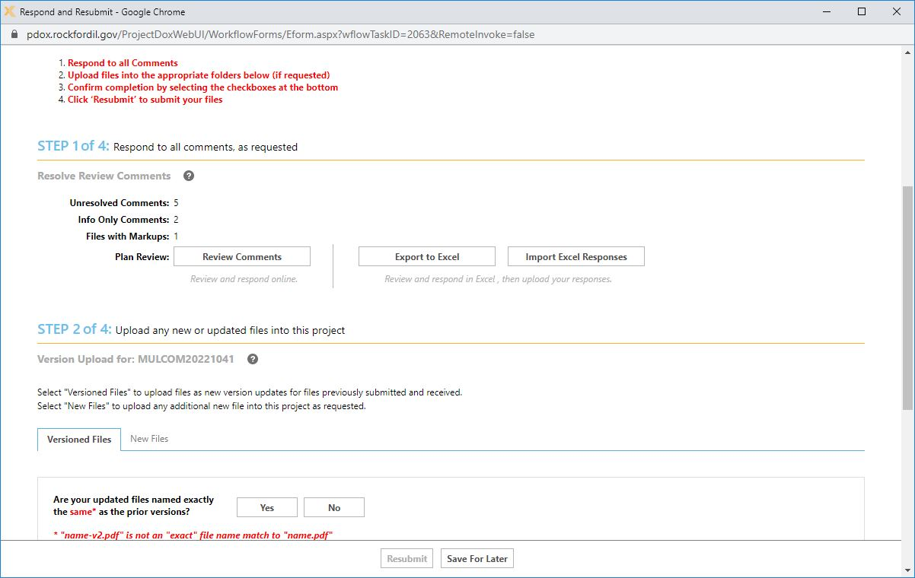

Comments

Slide 9
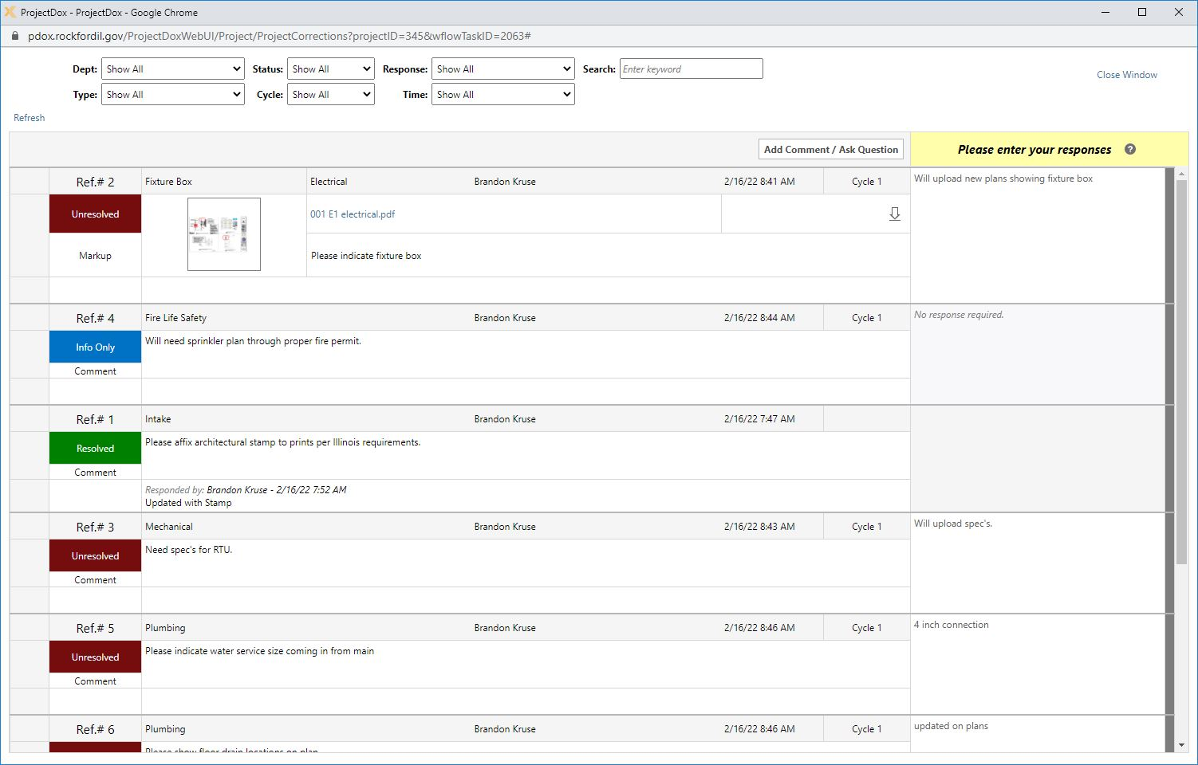
Comments Continued

Slide 10
Live Demo

Slide 11
Contact Information
Construction & Development Services
Front Desk
779-348-7158
Building Code Official
Nelson Sjostrom
779-348-7433 or nelson.sjostrom@rockfordil.gov
Construction Services Coordinator
Brandon Kruse
779-348-7440 or brandon.kruse@rockfordil.gov
Planner/Building Plans Examiner
Rudy Moreno
779-348-7445 or
rudy.moreno@rockfordil.gov
Fire Prevention Coordinator
Mike Rotolo
779-500-6544 or mike.rotolo@rockfordil.gov
Public Works Coordinator
Jeannette Smith
779-348-7610 or
Jeannette.Smith@rockfordil.gov
General Questions &
Help
Projectdoxhelp@rockfordil.gov

