Slide 1

City of Rockford Public Works Pre-Construction Meeting Spring 2025

Slide 2
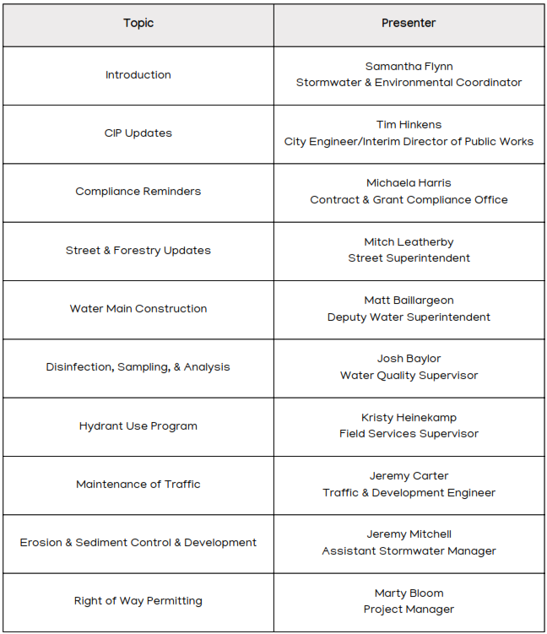

Agenda

Slide 3
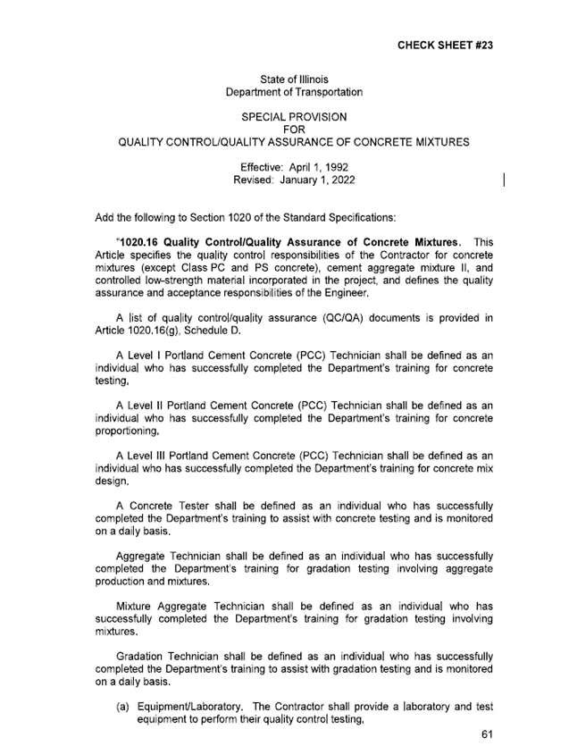
CIP Update: Check Sheet #23 Enforcement
This IDOT Special Provision will be enforced on all projects that include Check Sheet #23 in the contract documents.
Contractors will be responsible for quality control of concrete mixtures which includes inspection, sampling, testing and documentation.

Slide 4

Compliance Reminders
Prevailing Wage Law
Davis-Bacon Act
Certified Payroll Record Requirements
Subcontractor Utilization
Site Visits
For questions after today, contact:
Michaela Harris
Contract and Grant Compliance Officer
(779) 348-7264
Michaela.Harris@RockfordIL.gov

Slide 5
Prevailing Wage Law
Bid specifications and requests for proposals indicate whether prevailing wage law applies to the project.
If the project is locally funded, Illinois Prevailing Wage Act (IPWA) applies.
If federally funded, Davis Bacon and Related Acts (Davis Bacon) apply.
Additionally, Federal guidance is that if a project is dually funded with both State and Federal funds, the Contractor is required to pay the higher of the two wage requirements. So, even if a project is federally funded and Davis Bacon applies, if State funds that are covered under the Illinois Prevailing Wage Act are also used on the project, the higher wage of the two must be paid.

Slide 6
Prevailing Wage Law
Contractors are responsible for understanding and complying with their obligations under applicable law. Key obligations for primes:
Notifying subcontractors when their work is subject to the law;
Paying prevailing wage rates for the proper classification of worker;
Filing timely Certified Payroll Records with the State;
Ensuring subcontractors file timely Certified Payroll Records with the State; and
Completing the acknowledgement form for work under $25k and providing certification of payroll submission to the City.

Slide 7
Prevailing Wage Law
When IPWA applies, contractors and subcontractors are responsible for staying current with the Illinois Dept. of Labor wage determinations (they can change at any time). If the State changes the prevailing wage during the course of the project, the contractor must pay the new wage.
Up-to-date wage determinations can be found on the Illinois Dept. of Labor’s website: https://www2.illinois.gov/idol/Laws-Rules/CONMED/Pages/Rates.aspx.
Davis Bacon wages are locked in, usually at the time of bid opening—they don’t change throughout the course of the project. The wage determinations are included in the City’s advertised bid documents.

Slide 8
Certified Payroll Records
The prime contractor and subcontractors must enter weekly Certified Payroll Records (CPRs) in the Illinois Department of Labor Prevailing Wage Portal.
The Portal will produce a PDF of the wages the contractor has submitted. The City requires the contractor to complete a certification form that all certified payroll has been submitted to the State for the time period it is requesting payment.
An invoice will not be considered complete without this certification.

Slide 9
Certified Payroll Records
The City will withhold payment of invoices for projects where the prime or subs have not complied with the requirement to file CPRs.
IPWA requires payroll records be submitted to the State by the 15th of the month for the preceding month.
Final payment will not be released until all CPRs have been certified as submitted to the State.
Davis Bacon contracts require that certified payroll be submitted weekly. The City is no longer utilizing LCP Tracker, so certified payrolls will need to be emailed to the Contract & Grant Compliance Officer at Michaela.Harris@rockfordil.gov.

Slide 10
Subcontractor Utilization
All invitations for bids and requests for proposals require the contractor to complete a Subcontractor Utilization Form.
The City uses the information to track MWBE utilization.
If any of the information on subcontractor utilization changes, you must submit an updated form to the Contract Compliance Officer.
Changes include:
If you use a different or additional subcontractor(s)
If the amount estimated for the value of subcontract work increases or decreases
If the number of individuals employed by the company changes

Slide 11
Subcontractor Utilization-mwbe
The City strongly encourages the use of minority and women business enterprises (MWBEs) as subcontractors for City projects.
On the City’s Subcontractor Utilization Form, contractors are required to provide information on their efforts to identify MBWEs for subcontracting opportunities.
An up-to-date list of City-certified MBEs and WBEs can be found on the Purchasing website page: https://rockfordil.gov/city-departments/finance/central-services/purchasing/.
Any state-certified DBE, MBE, or WBE also qualifies. To search for state-certified businesses, go to the CMS website https://cms.diversitycompliance.com/ and the Illinois Unified Certification Program Directory at https://webapps.dot.illinois.gov/UCP/ExternalSearch.

Slide 12
Site visits
The City must monitor compliance with Davis Bacon through site visits:
Includes conducting confidential interviews with workers at the job site, comparing interview information to certified payrolls.
Duties actually performed vs. wage classification on payroll
Hours and days actually worked vs. payroll
Compensation actually paid vs. payroll
Includes verifying notice requirements are being met (wage determinations posted on site and Dept. of Labor WH-1321 “Employee Rights Under the Davis-Bacon Act” poster displayed on site -- found at https://www.dol.gov/whd/programs/dbra/wh1321.htm).
The City may also choose to conduct prevailing wage site visits for locally funded projects subject to IPWA.

Slide 13

Street/Forestry Contacts
Street & Transportation Superintendents:
Mitch Leatherby – (779) 348-7631
Mitchell.Leatherby@rockfordil.gov
Nick Akers – (779) 348-7619
Nicholas.akers@rockfordil.gov
Street Div. Supervisor:
Giovanni Giacomazzo-(779) 348-7675
Giovanni.Giacomazzo@rockfordil.gov
Forestry Div. Supervisor:
Taylor Hennelly– (779) 348-7636 Taylor.Hennelly@rockfordil.gov

Slide 14

Water Distribution System Design and Specifications (Section 12)
Most recently revised April 2024 to reflect combined fire and domestic water service installations.
Previous changes discuss the abandonment provisions associated with unused water service lines; Abandonment requirements shall be size dependent and will either be abandoned by using a solid sleeve, corporation sleeve, or removing and replacing a section of main.
IL Admin Code 890.120
Current Version is available on the City Website (rockfordil.gov) under City Departments – Public Works – Water – Design & Construction (link on left side)

Slide 15
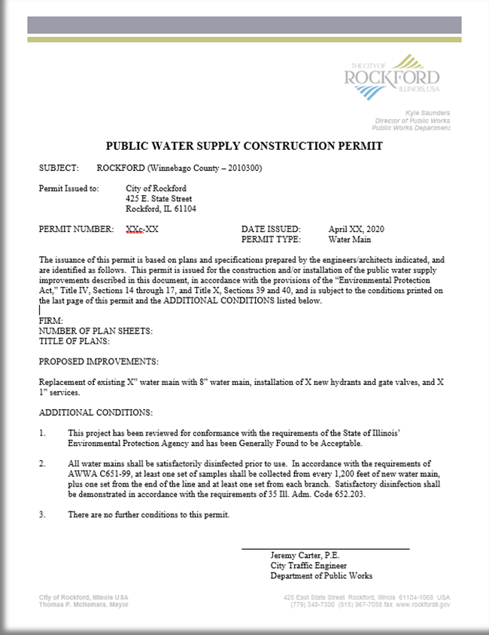
Illinois EPA Water Construction Permit
Prior to Permit Approval:
Approved Plat
Approved Plans
Submit 2 copies of the Construction Permit Application
Prior to Construction:
Receive Permit
Preconstruction Meeting

Slide 16
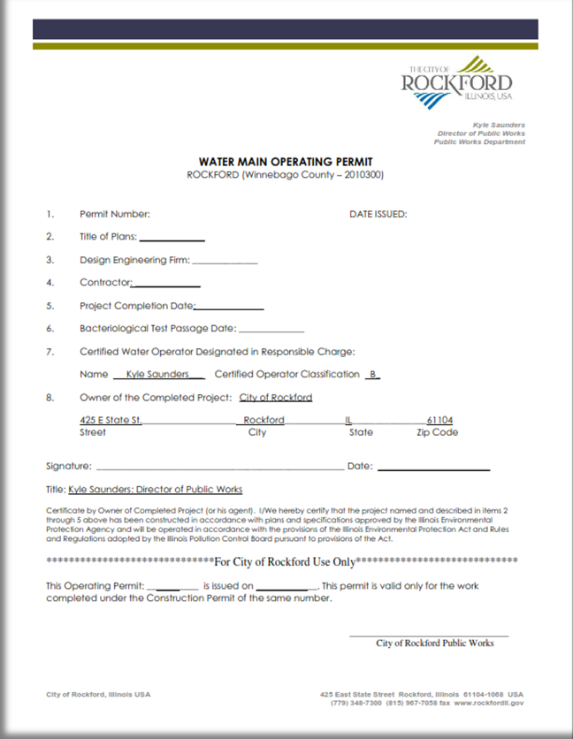
Illinois EPA Water Operating Permit
The City of Rockford issues an Operating Permit once the water main has passed all tests and has been accepted by the Water Engineer.
This permit is kept on file with the Water Division

Slide 17

Water System Shutdowns
Water Main Shut Off:
Section 1.6 - Requirements for Scheduled Water Main Valve Shut Off
Section 1.6.1 - Requirements for Unscheduled (Emergency) Water Main Valve Shut Off
This section can be found on the City’s website under City Departments – Public Works – Water – Water Engineering

Slide 18

Water System Shutdowns
Section 1.6 - Requirements for Scheduled Water Main Valve Shut Off:
Must obtain permission of the Water Superintendent, or his designee, prior to any water main valve shut off.
Meet with Water Division personnel at least five (5) days prior to start of construction
Coordinate exercising valves and determining valve shut off patterns during construction.
The shut down shall be allowed to proceed only after the Water Division representative has determined that the required valves are functioning.
Minimum 24 hour notification to all customers of boil order (tags)
For larger businesses, schools, etc. coordinate shutdown in advance with Property Owner and Project Manager

Slide 19
Water System Shutdowns
Section 1.6 - Requirements for Scheduled Water Main Valve Shut Off (Cont.):
Notify the Water Division Operations Center (779-348-7368) prior to water main valve shut off and provide the following:
Streets and boundaries of shut down
Time of shut down
Approximate duration of shut down
Number of customers affected
If non-residential customers (hospitals, nursing homes, restaurants, etc.) are affected, a count of how many individuals affected.
Notify Water Division Operations Center Operator upon completion of repairs and restoration of water service.

Slide 20

Water System Shutdowns
Section 1.61 - Requirements for Unscheduled Water Main Valve Shut Off:
In the event the Contractor must perform an unscheduled water main valve shut off; the Contractor shall notify the Water Division Operations Center Operator (779-348-7368) as soon as possible.
All Hi-Lo Valves are marked with a special manhole cover, and all operation of these valves shall be by City of Rockford staff ONLY!

Slide 21
Water Main Inspection
All inspections will be performed by the City of Rockford or their designee.
All Illinois EPA and Plumbing regulations shall apply for inspection purposes.
All requests for inspections shall be no less than 24 hour advance notice.
All Components needing inspections shall remain exposed until inspection is complete.

Slide 22
Disinfection
American Water Works Association (AWWA):
C651 – Water Main Disinfection
B300 – Standard for Hypochlorite
B301 – Standard for Liquid Chlorine
Administrative Code Title 35; Section 602
Administrative Code Title 35; Section 652
City of Rockford Chapter II; Section 12
Standard Specifications for Water & Sewer Main Construction in Illinois
Make sure the hydrant is sufficiently flushed to at least one (1) ppm free chlorine before collecting and submitting your BacT sample

Slide 23

Bacteriological Sampling & Analysis
The City of Rockford will perform ALL BacT analysis for City of Rockford construction projects.
Sampling Requirements:
Water main repair (no permit): 1 BacT sample - P&A (presence & absence method)
Upsizing or relocation of main (needing a permit): 2 BacT consecutive samples (at least 24 hrs apart) – P&A method
New construction (not routine & needing a permit): 2 BacT consecutive samples (at least 24 hrs apart) – P&A method

Slide 24
Rockford Water Division Environmental Laboratory
Location: 1111 Cedar Street
Samples accepted between 6:00am–2:00pm, Monday–Thursday
After hours kiosk available Monday–Thursday any time.
Bacteriological Analysis Pricing:
Presence & Absence: $20.00
Samples are accepted on weekends with prior approval.
Samples will be submitted in laboratory approved containers that are available at 1111 Cedar Street.
Samples will not be accepted without properly completed paperwork.

Slide 25
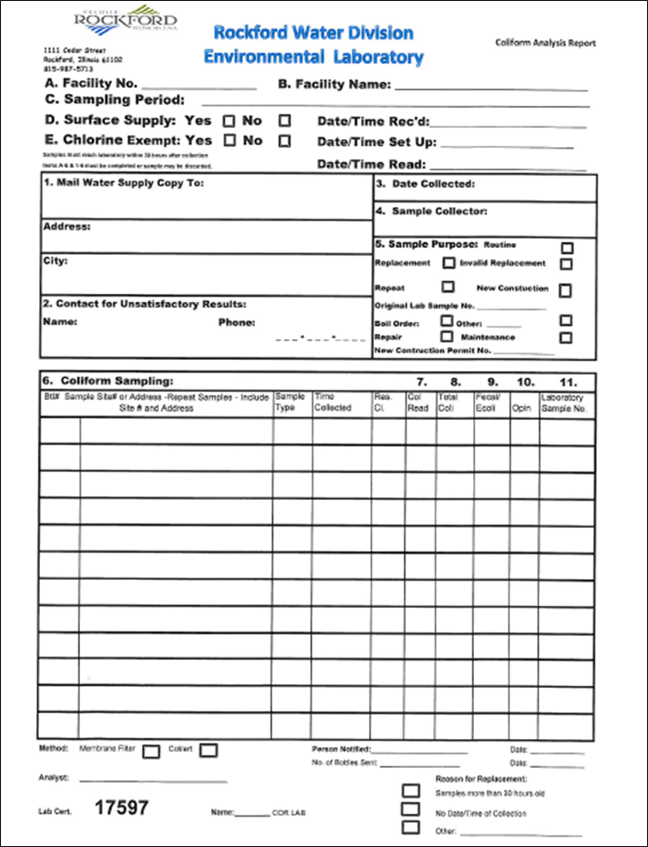

Rockford Water Division Environmental Laboratory
Form MUST include total or free residual chlorine at the time sample is collected
Acceptable Levels:
Form must also have the following complete:
Facility Number
Facility Name
Date Collected
Section 1
Section 2
Sample Collector
Sample Purpose
Permit Number
Sample Name or Address
Time Collected
INCOMPLETE FORMS WIL NOT BE ACCEPTED

Slide 26

Hydrant Permits & Hydrant Meter Requests
HYDRANT METER REQUESTS:
Please fill out the Hydrant Request Form, located on the City of Rockford Website, https://rockfordil.gov/city-departments/public-works/water-division/
Or call our office at (779) 348 -7152 between hours 7:30am -3pm and we will be happy to email the link for the form

Slide 27
What do we need?
Be ready with the following information:
Hydrant Location(s)
Project Name
Project Location
Project Purpose
Dates the hydrant(s) and meter are needed
W-9 form (email or bring copy at pick-up)

Slide 28
Approval
All requests for hydrant use must be approved by the Water Engineer and the Water Quality Supervisor.
The Engineering and Water Quality Department reviews your choice for the hydrant location request for the following:
The meter size (1 or 2 inch)
How long it will be used
How it will affect the water main
How it will affect possible traffic flow when filling a water tanker truck
To avoid delay please submit the Hydrant Meter Request form a minimum of 24 hours prior to when you would like to pick up the meter.

Slide 29
PAYING FOR YOUR METER
Payment and Pick-up:
Once approved-we will contact you by phone or email to let you know the meter is ready for pick-up
Make your payment at City Hall Payment Center 425 East State St (8am – 5pm, Mon – Fri)
Bring your receipt and a copy of your W-9 to the Water Operations Center located at 1111 Cedar Street (7:30am – 3pm, Mon – Fri)
Costs:
$800.00 – 1 inch Meter
$2,000.00 – 2 inch Meter
$20.00 per month Hydrant use permit fee
Water is billed $8.70 per unit.
Any damage to meters is deducted from deposit

Slide 30
Bringing the Meter Back
Returning your meter:
Bring to:
Water Operations Center located at 1111 Cedar Street
7:30am – 3pm, Monday - Friday
WE will:
Read the meter
Document your contract with the meter read
Check for any damages to the meter
Give you a signed copy as your receipt
ALL CONTRACTS EXPIRE 12-31-25. YOU MUST RETURN YOUR METER AND UPDATE YOUR FORMS FOR THE 2026 SEASON.

Slide 31

TIPS FOR PROPER USE
DO
Do not
Open/close hydrant slowly
Use specialized hydrant wrench
Keep a copy of hydrant permit(s) on-site (digital is fine)
Brace bottom of meter
Store in warm place to avoid freezing
Please report any problems immediately
Leave meter unattended
Use a different hydrant unless approved
Using a hydrant without authorization from the Water Division could result in a fine.

Slide 32
Maintenance of Traffic
Maintenance of Traffic Plans are require for any lane or sidewalk closure and are the responsibility of agency proposing the closure.
Per ordinance, closure of collectors require minimum 24hr notice to the City and closures of arterial roads require a minimum 48hr notice.

Slide 33
Maintenance of Traffic
Detours are required when at least one lane of traffic in a direction can not be accommodated on arterials and major collectors.
Detours must be to similar roads:
Truck Route to Truck Route
Arterial to Arterial
In other words, do not detour a major road onto a local road and think that will work.

Slide 34
Maintenance of Traffic
Daytime Lane Closures:
Closure should meet IDOT standards
Tall cones are now accepted for lane closures
Overnight Lane Closures:
Must provide 24hr a day available contact for traffic control set up
Cones are not accepted for overnight lane closures
Sidewalk Closures:
ADA detour must be provided
Signage should be placed at locations allowing for ADA crossing of the roadway

Slide 35
Stormwater Permitting Requirements
NPDES Municipal Separate Storm Sewer System (MS4) Stormwater permits requires municipalities to implement an erosion and sediment control inspection and enforcement program.
All projects within City of Rockford limits must comply with the City’s Subdivision review process as well as the Public Works Department - Engineering Division’s Plat and Plan Review Process. Construction shall not begin until the City has completed it’s review process and has issued approvals.
For City and private projects, SWPPP’s and erosion control plans must be reviewed by the Stormwater & Environmental Team.
To avoid confusion, City of Rockford erosion and sediment control requirements are the same as Illinois EPA.
IEPA approval of permits does not mean the City has approved a permit.

Slide 36
Stormwater Permitting Requirements
All projects with one acre or more of disturbance will require an IEPA General Construction Permit and a SWPPP. A Notice of Intent (NOI) and SWPPP must be submitted with the IEPA a minimum of 30 days prior to starting construction. A fee is required along with the submittal. A permit will not be issued until the IEPA has approved the SWPPP. The IEPA has a 30-day review policy.
All City projects requiring an IEPA construction permit shall submit the filled out NOI to the Project Manager or the City’s Stormwater team.
All projects regardless of site will require a Stormwater Management Permit.
If work does not commence within 2 weeks of the listed start date on the Grading Permit then the permit is no longer valid until the City of Rockford is informed of the new start date.
Permit is valid for two (2) years from date construction commences. Projects that extend beyond 2 years a new permit application and fee shall be submitted.
Note: IEPA has changed it’s website for permit submittals (https://cdxnodengn.epa.gov/net-cgp/action/login) During submittal, upload the SWPPP and Erosion control plans and any other pertinent documents. The submittal must be certified before IEPA accepts it and begins their review.

Slide 37
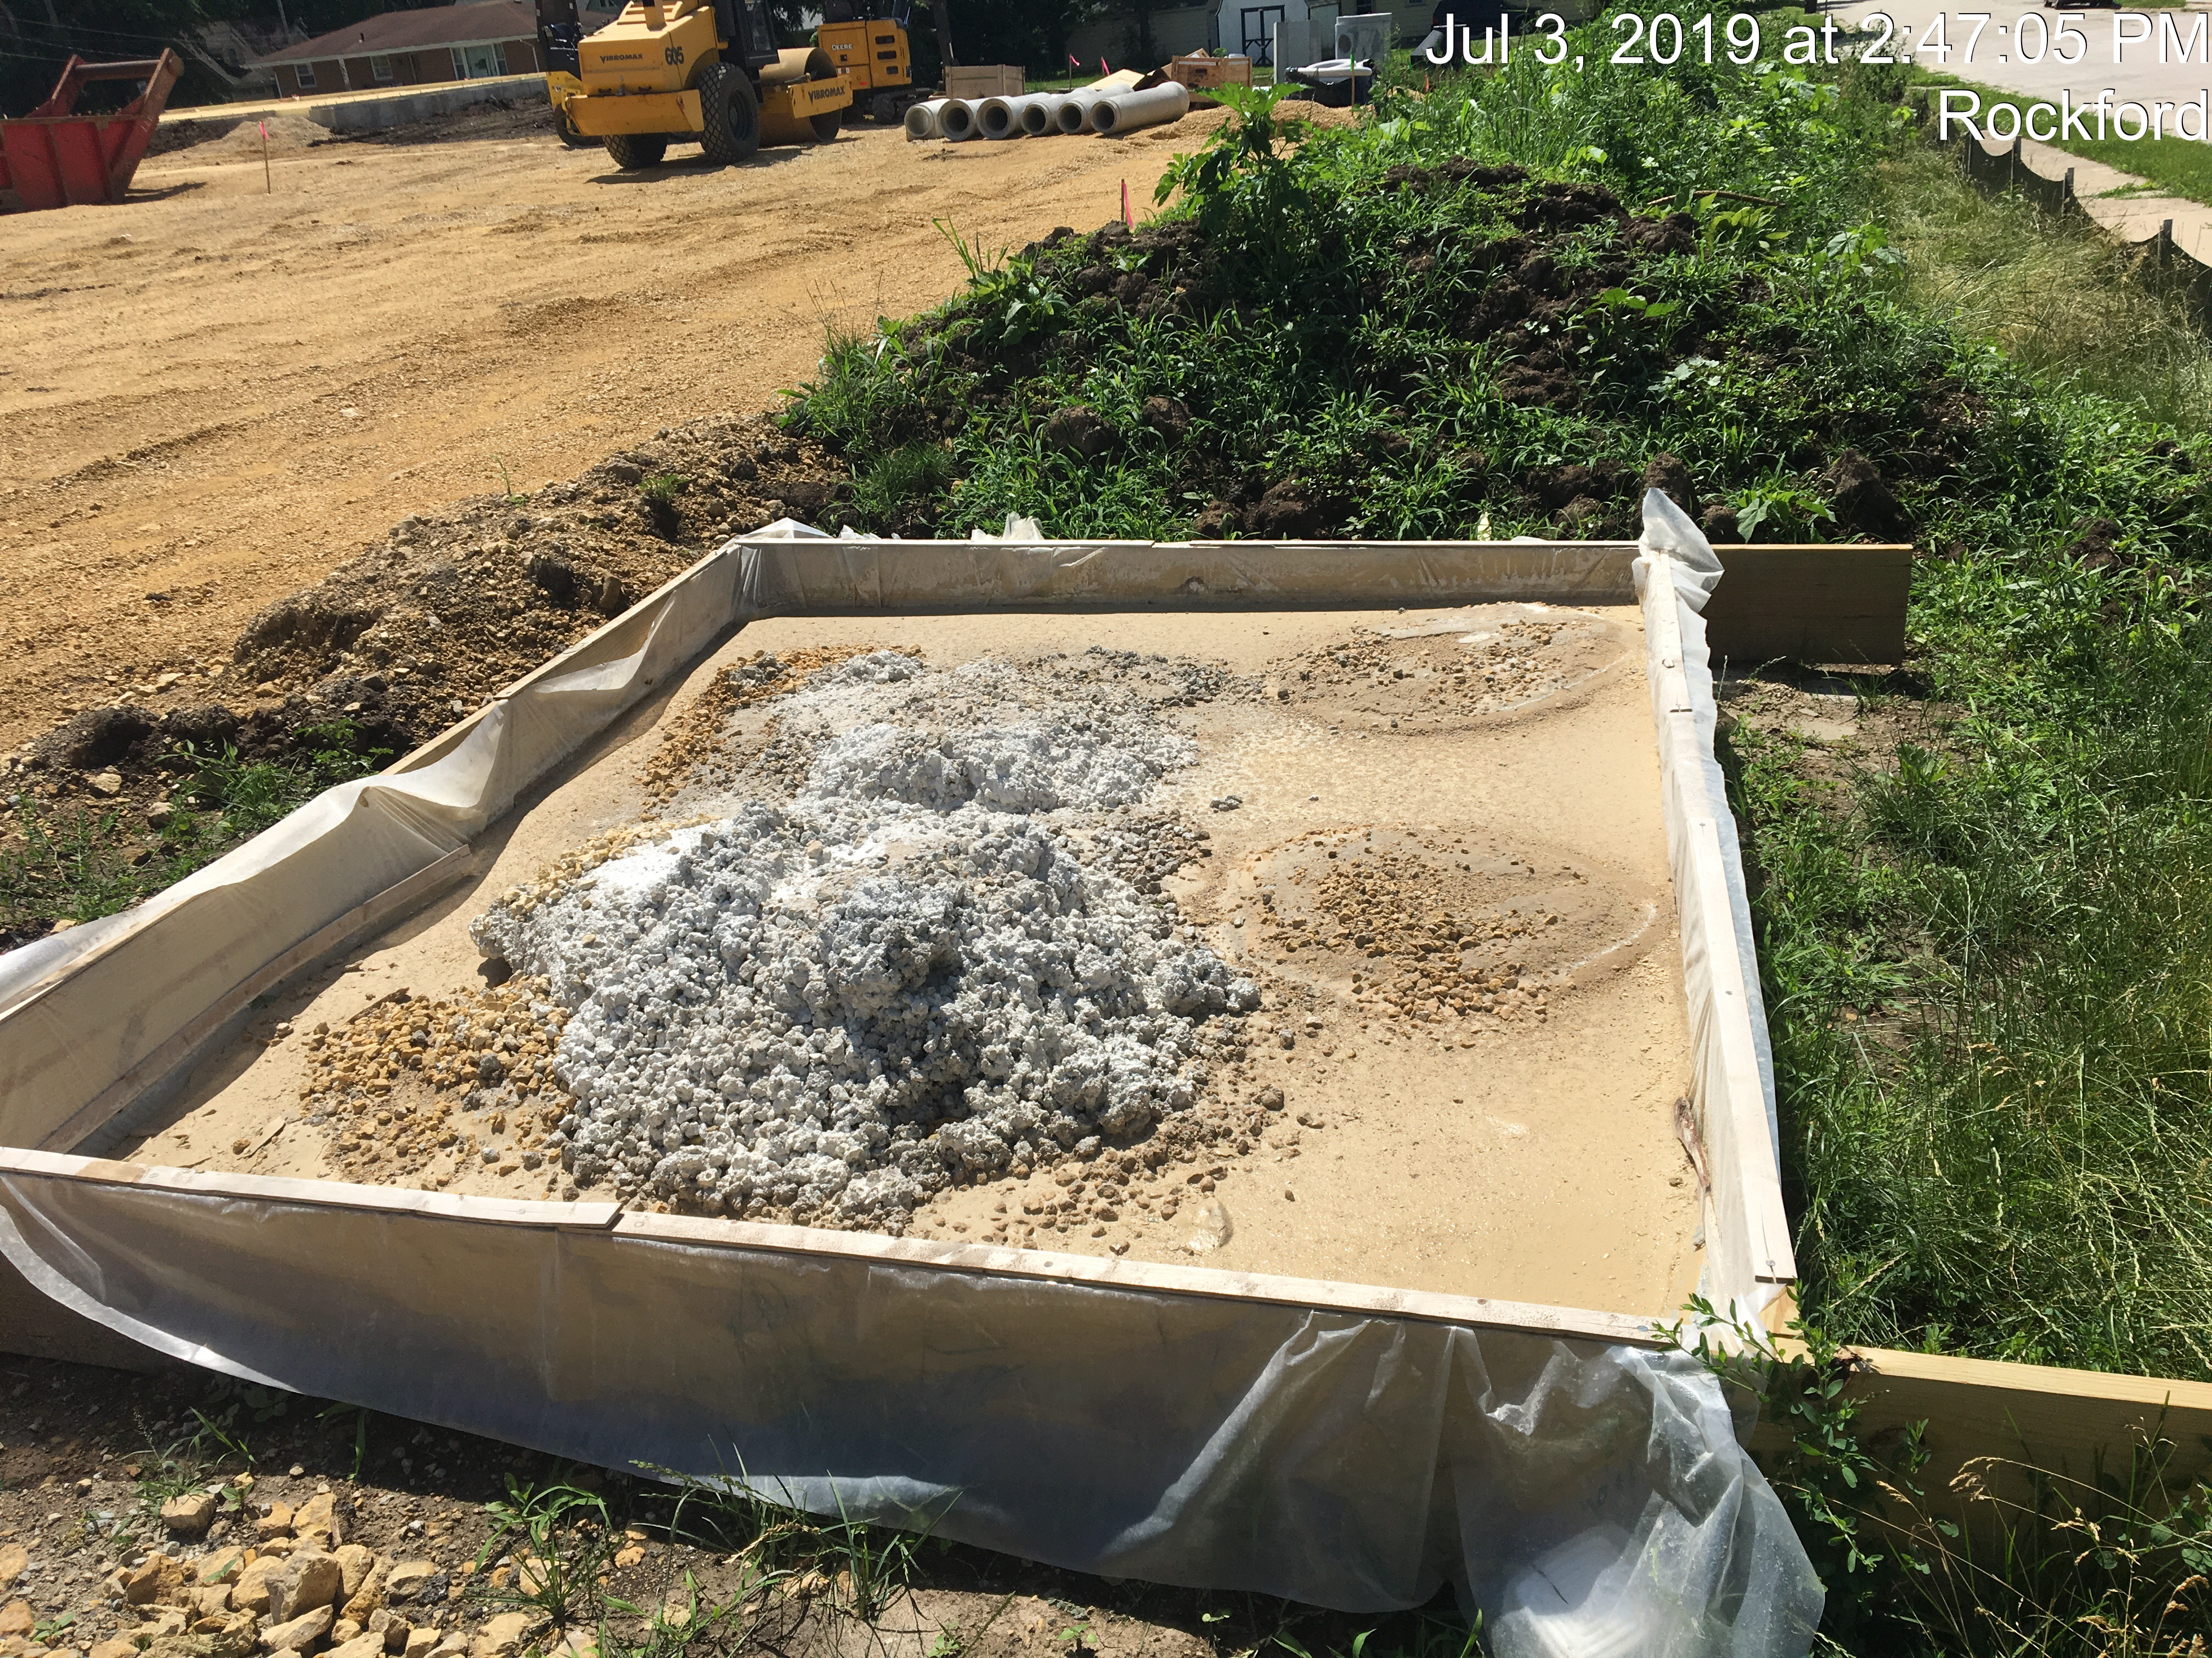
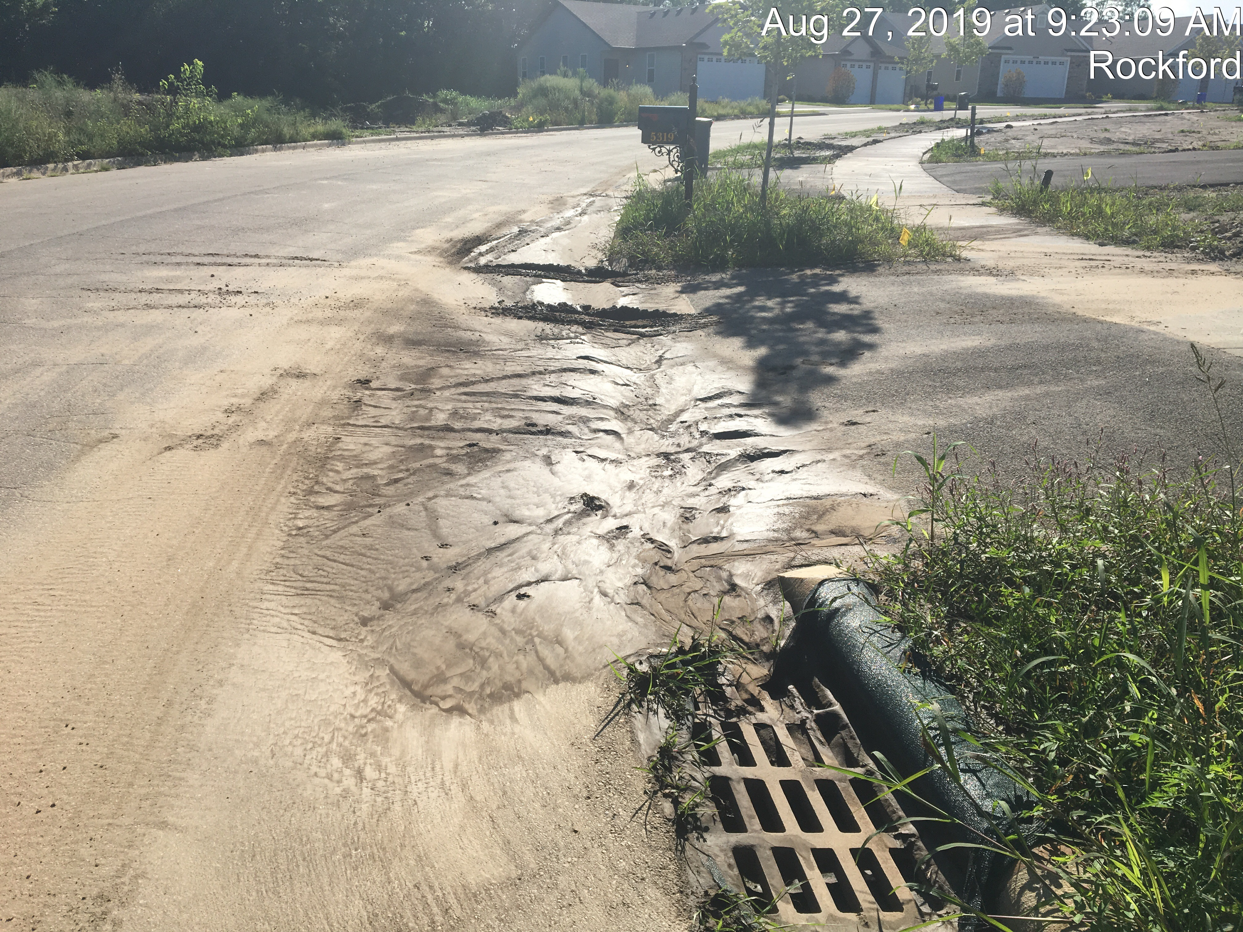
Erosion & sediment control inspections
WE EXPECT FULL COMPLIANCE AT THE TIME OF THE VISIT.
Compliance does not start when the regulatory inspector shows up.
Follow the erosion control plan and the BMP’s that were specified.
i.e. inlet protection
Remove all BMP’s when the project is completed.
Document everything! It didn’t happen if it’s not written down.
Grading start & end dates
BMP install & removal Dates
Stabilization dates
Inspections Dates & all BMP Maintenance
Any changes to the SWPPP.

Slide 38
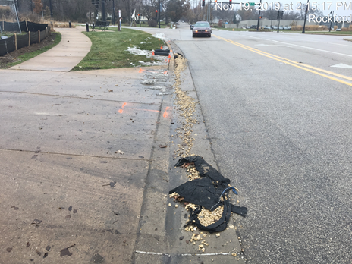
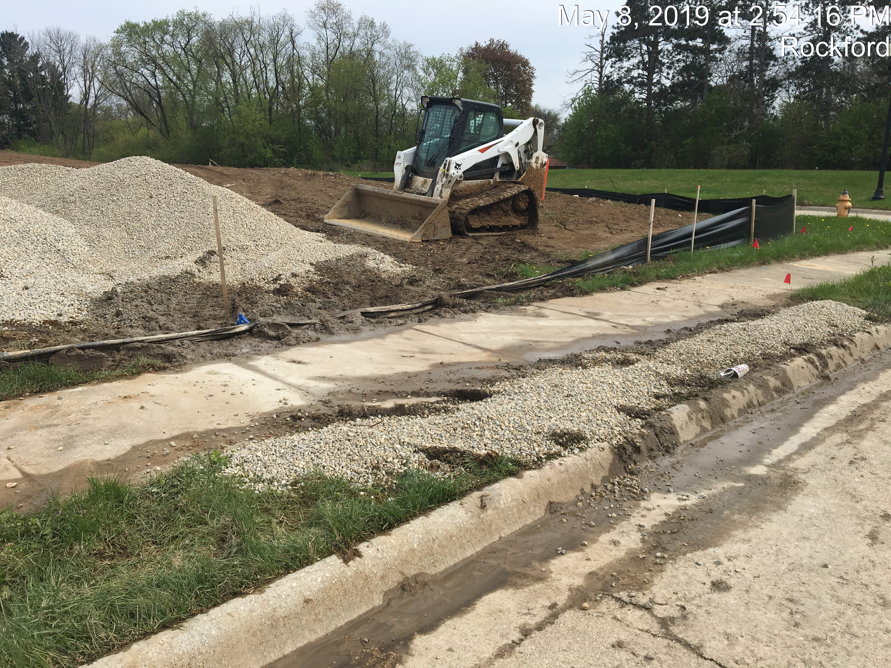
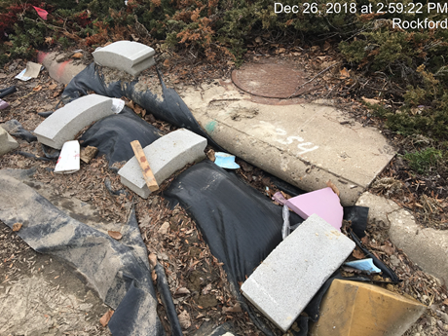
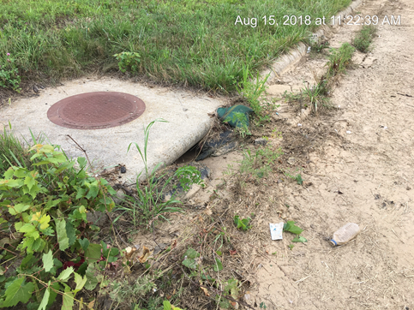
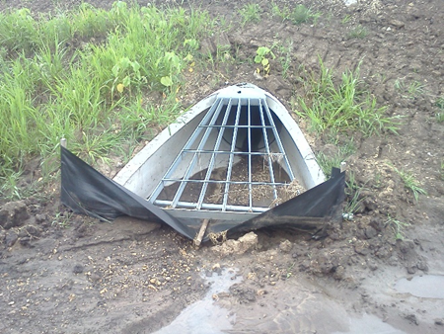
Pet peeves

Slide 39
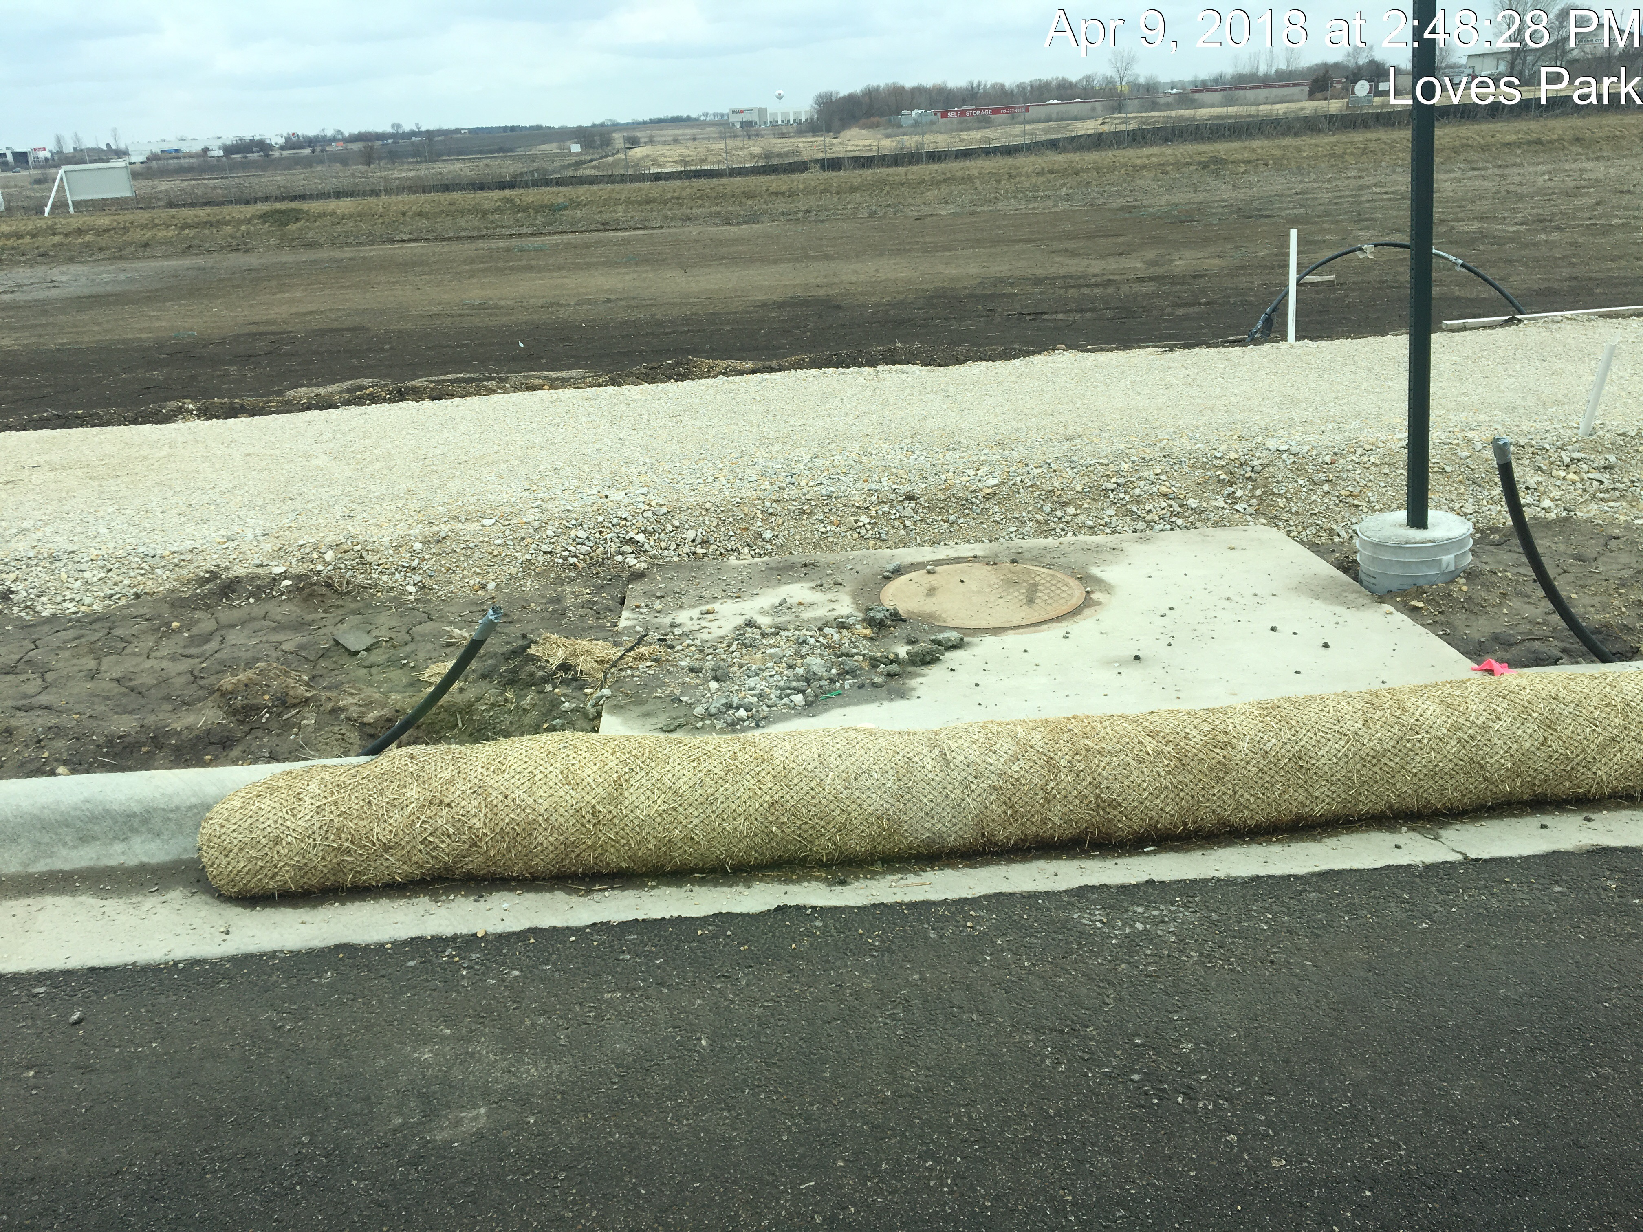
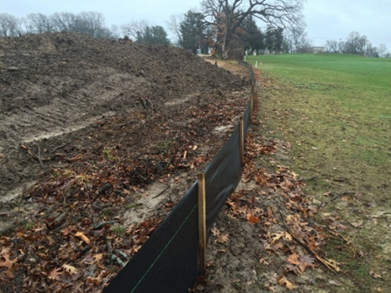
Erosion & sediment control inspections
Unless requested, all inspections are surprise visits. Appointments are not made.
The City will inspect any size construction site regardless of IEPA permitting requirements.
IEPA permitted sites require qualified personnel to inspect site once every seven calendar days and within 24hrs of the end of a storm that is 0.5 inches or greater.
BMP maintenance must be initiated immediately! Not when you get around to it!
Utilize the Illinois Urban Manual for proper Installations of BMP’s. https://illinoisurbanmanual.org/

Slide 40
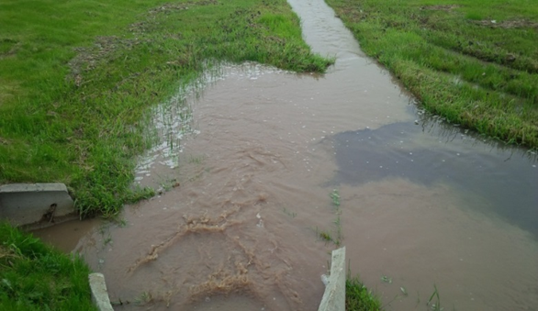
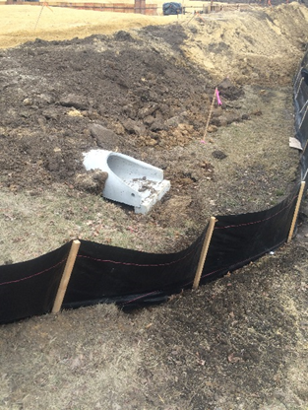
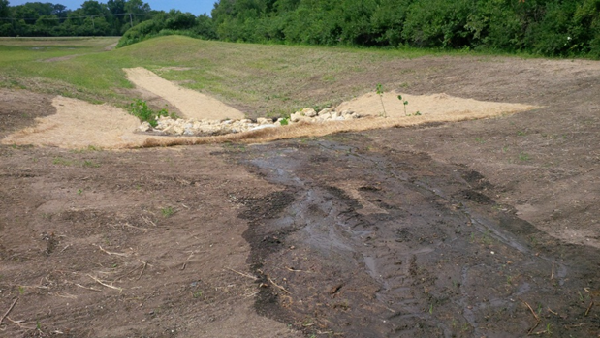
Discharge points
Where are the discharge points, are BMP’s in place?
Are there indications of offsite discharges?
Sediment deposits
Sediment laden water
Downstream erosion
See Title 35 of the Illinois Pollution Control Board,
Offensive Conditions (Part 302.203)
Offensive Discharges (Part 304.106)

Slide 41
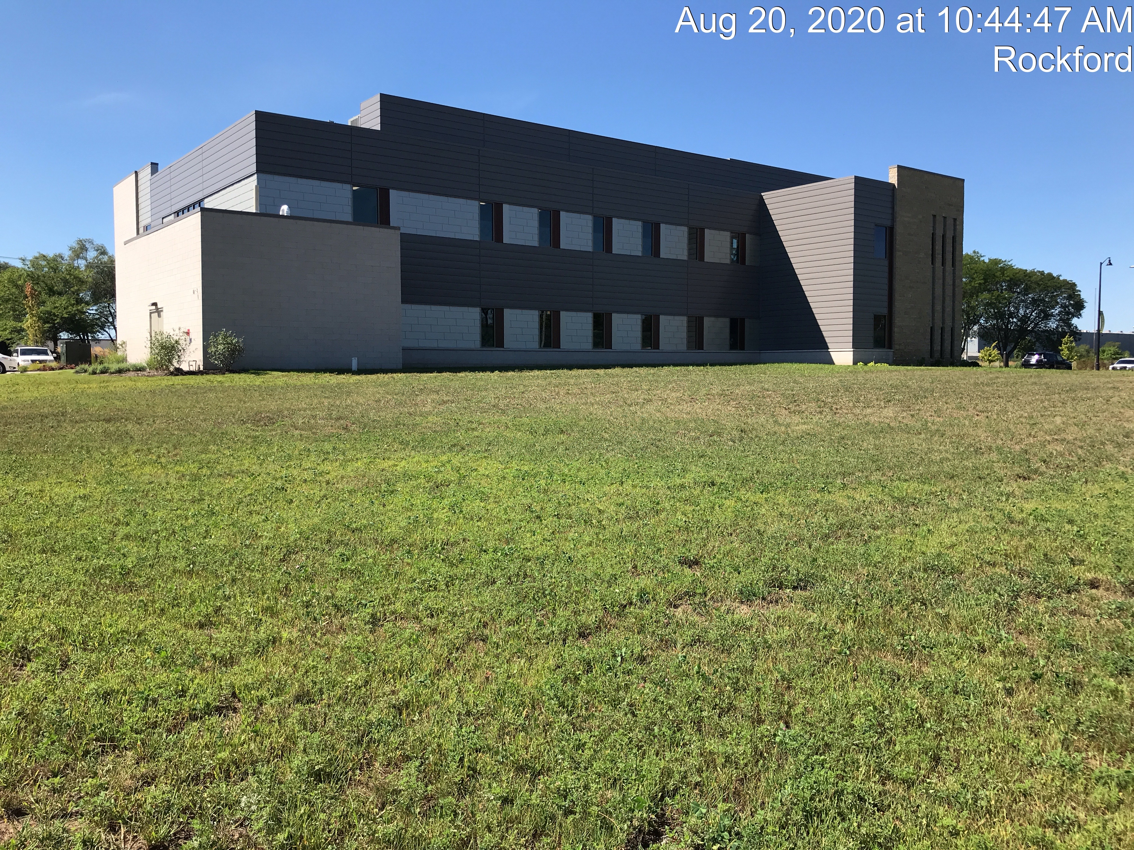
Terminating permits
Where a site has completed final stabilization and all authorized stormwater discharges from construction activities are eliminated the permittee MUST submit a completed notice of termination (NOT).
Final stabilization-all soil disturbing activities have been completed and:
A uniform perennial vegetative cover with a density of 70% for the area has been established on all unpaved areas.
or
Equivalent permanent stabilization measures (riprap, gabions, or geotextiles) have been employed.
Have all BMP’s been removed?

Slide 42
Development
Stormwater Management Ordinance & Stormwater Technical Manual:
New Flood Insurance Rate Maps effective February 17, 2016
In special flood hazard areas will need to construct lowest opening or flood proof to 2 ft. above the base flood elevation
If stormwater detention calcs result in an orifice less than 4” then detention is not required but best management practices for water quality control must be used on site
A Post Construction Management Plan is required for all sites with stormwater drainage systems

Slide 43
Development
Inspections:
Prior to starting any construction on a site you must call or email the Stormwater Team at (779)348-7175 or (stormwater@rockfordil.gov)
Lack of notification may result in a stop work order and/or code hearing where a fine is issued and may result in work not being accepted.
IDOT Spec Section 801 for Traffic Signals requires 30-Day Burn-In
Street Lighting will also require a 30-day burn in period prior to acceptance

Slide 44
Right of way permitting
Permits are required for all work in the ROW
Bond Requirements:
$50,000 Surety Bond – must show expiration date
The entity getting the permit must have the bond (if this is not the case it will hold up the permit).
Insurance Requirements:
All contractors doing work must have required insurance, and should be documented on permit application.
$3M General Liability per occurrence
or
$1M general aggregate per occurrence with a $2M umbrella under each occurrence for General Liability
COR must be listed as additional insured

Slide 45
Right of way permitting
Alterations to sidewalks must be replaced to ADA compliance.
Our team is available to pre-inspect. Call (779) 348-7174 to schedule
All new sidewalk through driveways must be ADA compliant PLUS a transitional panel on either side of the driveway to transition back to non-compliant sidewalk if necessary.

Slide 46
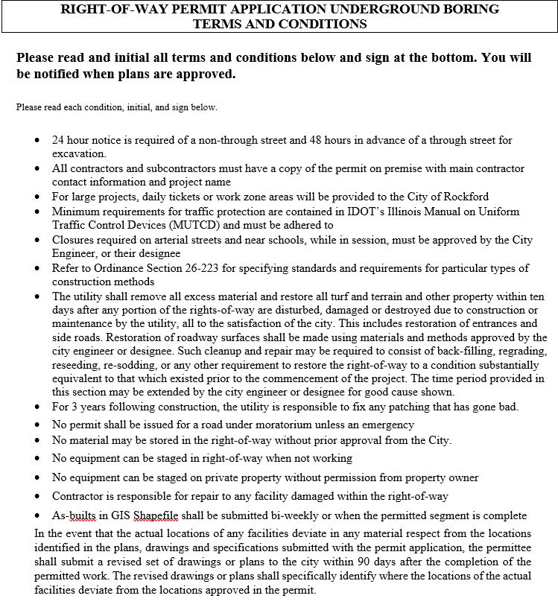
Right of way permitting

Slide 47
Right of way permitting
Parking Permits for work in time zone areas are required
The contractor(s) may contact ABM Parking Services at 815-968-5294 to purchase daily or monthly parking permits.
Contractors permits are $7.50/day or $30.00 per month

Slide 48
Right of way permitting
When you are ready to begin work in the ROW contact the permits desk:
Jordan Masemore, Sr. Eng. Tech: 779-348-7174
Jake Hennelly, Sr. Eng. Tech: 779-348-7670
Elyse Jacobson, Sr. Eng Tech: 779-348-7641
Tony Bilic, Sr. Eng. Tech: 779-348-7646
Marty Bloom, Permits Manager: 779-348-7648
Contractors can call and request pre-pour inspections on driveways and parking lots.

Slide 49
Important contacts
Stormwater/Erosion Control:
General SW (779) 348-7175
Water Main Design/Construction:
Jamie Rott (779) 348-7654
Development Plan Review/Inspection:
(779) 348-7354 or (779) 348-7663
Right-of-Way Permits/Inspections:
(779) 348-7174

